Slide 1

CSE3046 Project:
Building a Database-Driven Web-based Information system

Slide 2
Requirements
Build a database-driven web-based info. system
  Team work: 3-4 people
Goal:
  Identify an application domain that:
    Requires a database
    Accessible over the web
  Design the database
  Define application functionalities
  Implement
Milestone in 4 stages
  Due dates on Web site

Slide 3
The Most Important Slide
How to choose a good project topic?
  Your application must be useful
    Will there be people using your application?
    Why should they use your application?
  Your application must be realistic
    Your data must be real
      Where do you get your data?
    Amount of data in database must be reasonable
  You should have fun
  Find an application you like to do and have fun with it

Slide 4
What are some cool projects from past years?
Cavanaugh Mail System
  https://www.youtube.com/watch?v=UKZ9U1DCHmo
Paw Patrol
  https://www.youtube.com/watch?v=YCEW0MFn-d0
ICE Cloud
  https://www.youtube.com/watch?v=qgPmbFlXlAs
Eds Eatery
  https://www.youtube.com/watch?v=NOPa8qgm-yI
Pokedex 2.0
  http://www.youtube.com/watch?v=YTYQuESBvbU
Remember that your application can be the next startup

Slide 5
Any other interesting projects?
Entertainment:
  Book recommendation, music/playlist sharing, fantasy football analysis, ….
Productivity systems:
  Task management, human resource management, …
Healthcare:
  Physician recommendation
Social Media:
  DevianArt/Facebook mashup, …
Others:
  Stocks, weather tracking, academic ….
What is your crazy idea?

Slide 6
Past Projects (2020)
Whish List
Rational (Food Cart)
Multimember DJ
Grocerize
GameOn (Intramural Sports)
Music++
ScareBnB
PawPatrol
BarteNDr
BetterSports
ND Football Analytics
DonationDiscovery
TreNDy
Pollution Detector
Social Media Political Aggregator
Microbe Enrichment DB
F00dies
PathToTheParks
CaffControl
DanceDateFinder
SiggyZa (Siegfried Piazza Ordering)
StoryLine

Slide 7
Past Projects (2019)
Bringin the Band Together
On Demand Tutoring Service
Flex Points Management System
Workout Planner
Study Abroad Recommendations
Emergency Health Records
Bullying Incident System
Product Barcode Financial Information
MMA Analytics
Autism Law Resources Database
Trips Abroad
Reddit Post Predictor
Notre Dame Student Club App for First Years
Movie Trailor Mashup Selector
Holy Cross Recruitment App
ND Varsity Football Analytics
Dorm Selector
Love Finder
Finance in Your Pants
Knott Food Court
Meme Finder
Nice Mice (Mouse Breeding)
ISSLP Student Outcomes

Slide 8
Our Expectations:
Every stage must be approved to get a passing grade:
  Stage 0: Group formation
  Stage 1: Functional Desc / ER design
  Stage 2: Development Plan/Development environment
  Stage 3: Initial Data and Demo
  Stage 4: Final Demo and Report – Dec 15ish, 2021

Slide 9
Our Expectations:
Stage 1: Functional Description and ER design – 4%
Stage 2: Setup Development Environment – 3%
Stage 3: Initial Demo – 25%
  Data: Have real data (15%)
    >10,000 tuples total
  Insertion: Be able to insert record to DB
  Update: Be able to update record in the DB
  Deletion: Be able to delete record from DB
  Search: Be able to query DB and print the result
  Plan: Detailed plan for the rest of the project

Slide 10
Our Expectations:
Stage 4: (80%)
  Final Demo: 65%
    Everything should be working
  Final Report: 5%
    Review on the details of the implementation process
    Review on Challenges
    Any deviation from plan and the reason
  Demo: 10%
    2-3 minute Youtube video
You need to have a complete working system to get passing grade

Slide 11
Some other interesting projects from the past
Vantage
  https://www.youtube.com/watch?v=7ZqnYG6A0xU
Inventory Bank
  http://www.youtube.com/watch?v=favGw3w4nH8
Remember: This is your chance to work on your dream

Slide 12
Project Requirements
4 Basic functions:
  Insert records to the database
  Search the database and print returned results
    Must demo several interesting queries
    At least one query must involve join of multiple tables
    Must have real data in the system
  Show how to update records
  Show how to delete records

Slide 13
Project Requirements
2 advanced functions:
  Should be relevant and useful for your application
  Don’t exist in equivalent web sites/applications
  Go beyond the basic functions
  Should be technically challenging
    Need to spend some significant time (at least 2-3 days of work for the whole team per advanced function) to implement
    You should be able to define the technically challenging problem and your solution

Slide 14
Project Requirements
2 advanced functions:
  Using 3rd party API (e.g. Google Map API,…) will get you no points unless you do some challenging stuff on preparing/analyzing the require data
You need real data in the system. You can get that from any resource but there should be an easy automatic way to insert data whenever needed.
  If you rely on users to enter data into your system, you must have your project up and running at least 1 week before your demo.
  You can ask your friends, TAs, student of class to use your system but you are responsible to get real data into your system

Slide 15
Project Requirements
Examples:
  Creative use of Google Maps
    Pokedex: Overlay pokemon world onto Google Map
    Google Map itself receives 0 points
  Cellphone App for iOS/Android can get you good grade
  Not:
    User-friendly interface
    “I code the site with ajax”

Slide 16

Project Requirements
Google Maps does not count

Slide 17
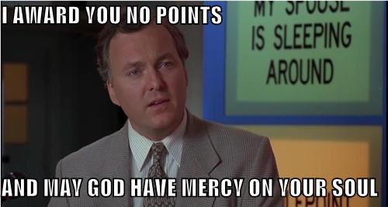
Seriously: You can use Google Maps if you want, but it will not count towards your advanced project

Slide 18
Manipulation of Social News
How the Web Works:
Client
Access the web app
Example: IE, Firefox, iPhone, Chrome, Android
Presentation
Renders information, generates webpages
Example: HTML, DHTML, XML, Javascript
Manage data access, performs calculations, makes logical decisions
Example: ASP, PHP, Perl
Logic
Database
Stores and manages data
Example: MySQL, Oracle

Slide 19
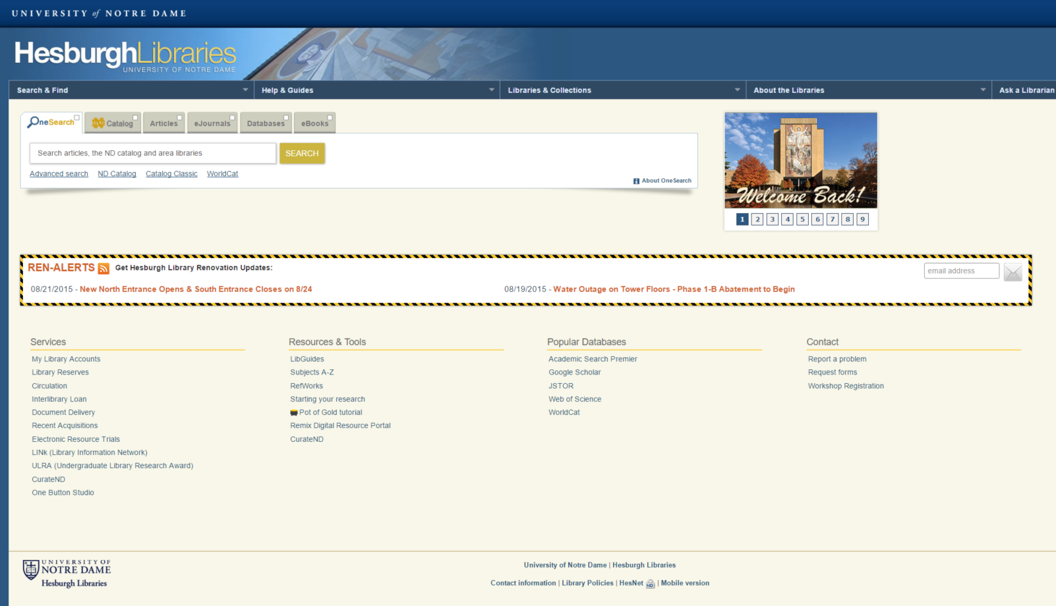
Manipulation of Social News
How the Web Works:
Client
Application is a website accessible via a web browser:
Presentation
Logic
Database

Slide 20
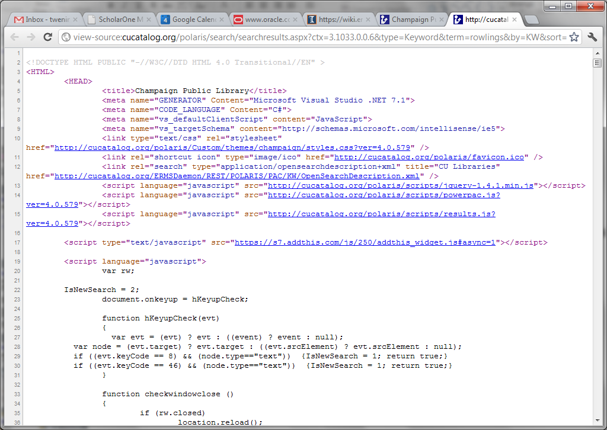
Manipulation of Social News
How the Web Works:
Client
Presentation
Use HTML and Javascript to create Web site
Logic
Database

Slide 21
Manipulation of Social News
How the Web Works:
Client
Presentation
Logic
PHP, et al., takes a string input and makes a SQL query
Database

Slide 22
Manipulation of Social News
How the Web Works:
Client
Presentation
Logic
Database
Mysql processes the query and returns results

Slide 23
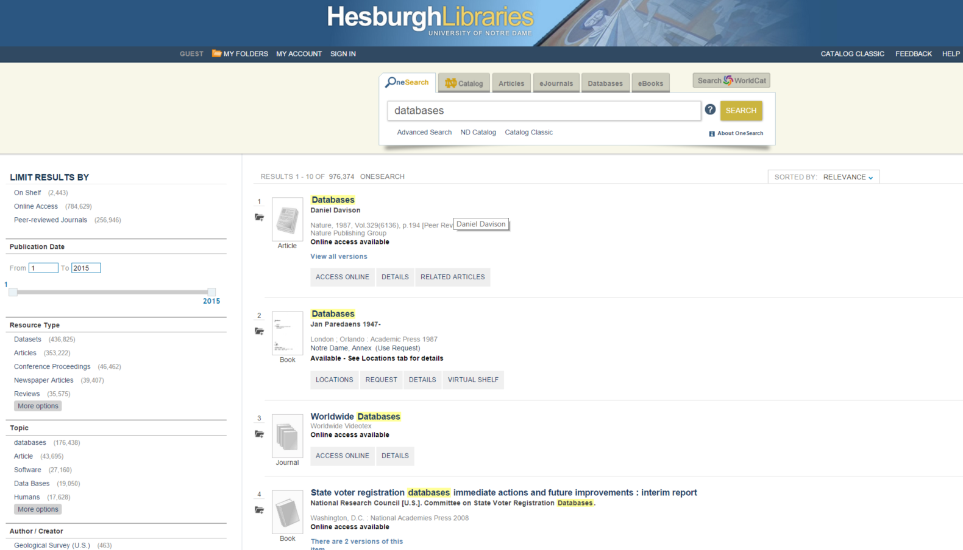
Manipulation of Social News
How the Web Works:
Client
Presentation
Logic
PHP, et al., processes the results, i.e., turns database objects into book records
Database

Slide 24
Manipulation of Social News
How the Web Works:
Client
Presentation
HTML and Javascript render the results
Logic
Database

Slide 25
Manipulation of Social News
How the Web Works:
Client
Client displays the results
Presentation
Logic
Database

Slide 26
Manipulation of Social News
How to implement a Web Application
Client
Client
Presentation
Internet
Server
Logic
Database

Slide 27
Manipulation of Social News
How to implement a Web Application
Client
Client
Presentation
HTML, JavaScript, CSS
Logic
Database

Slide 28
Manipulation of Social News
How to implement a Web Application
Client
Presentation
Server
Logic
PHP, ASP, Python, Java
Database

Slide 29
Manipulation of Social News
How to implement a Web Application
Client
Presentation
LAMP – Linux, Apache, MySQL, PHP
Server
Logic
Web Server
Database
DB Server

Slide 30
Common Tools
Framework:
  LAMP
  Client side:
    Examples: CSS, Flash, HTML, DHTML, Javascipt
  Server side:
    Examples: ASP, Java, Perl, PHP, Python, Ruby
  Web server:
    Examples: Apache, Tomcat
  Database:
    Examples: MySQL, Oracle, Postgres

Slide 31
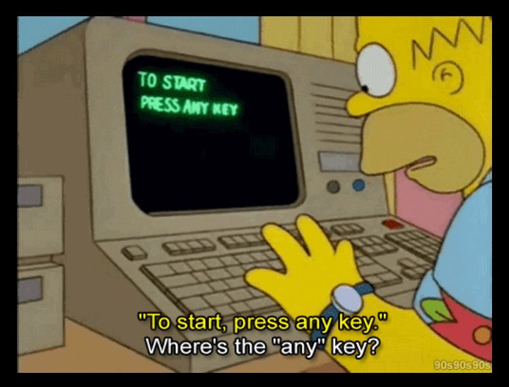

Slide 32
Manipulation of Social News
We will help you with Project Tutorials
Client
Client
Presentation
Web Programming Tutorial 1
Logic
Server
DB Programming
Tutorial 2
Database

Slide 33
Project Tips:
Read Projects page on the Website to get started
I will provid development environment
  Database: MySQL
  Web server: Apache2
Start early
  There will be unexpected issues
  Form groups now
  Do not try to collect your own data.
Have a questions? Problem forming group?
  Post to Campuswire.

Slide 34


