Slide 1
Generative Adversarial Network Rooms in Generative Graph Grammar Dungeons for The Legend of Zelda
Jake Gutierrez and Jacob Schrum

Slide 2
The Paper(s)
Gutierrez, J. and Schrum, J., 2020, July. Generative adversarial network rooms in generative graph grammar dungeons for the legend of zelda. In 2020 IEEE Congress on Evolutionary Computation (CEC) (pp. 1-8). IEEE.

Slide 3
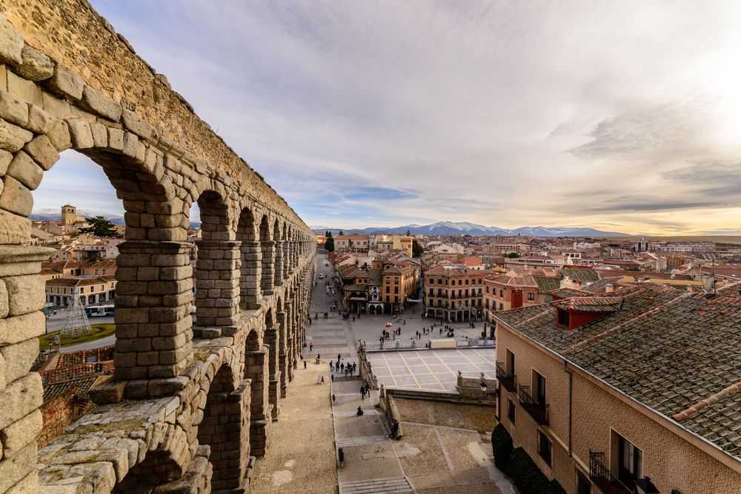
The But

Slide 4
GANs + Graph Grammars
“Generative Adversarial Networks (GANs) have demonstrated their ability to learn patterns in data and produce new exemplars similar to, but different from, their training set in several domains, including video games.
However,
GANs have a fixed output size, so creating levels of arbitrary size for a dungeon crawling game is difficult. GANs also have trouble encoding semantic requirements that make levels interesting and playable.”

Slide 5
Why is this important?
“Video game developers increase replayability and reduce costs using Procedural Content Generation (PCG [1]). Instead of experiencing the game once, players see new variations on every playthrough.”

Slide 6
Research Questions
RQ1: Can graph grammars or graph+GAN models do better than the original game?

Slide 7
Ways of Knowing

Slide 8
User study
“The study had 30 participants (university students, faculty, and staff). Each participant played through a dungeon of each of the three types in a different order (5 per each of 6 possible orders). After each dungeon, the participant took a survey ranking the dungeon on a 1–5 scale in various categories. After the second dungeon, users indicated which of the two were better in various respects, and after the third dungeon all three were ranked relative to each other. Participants also provided open-ended text responses at each stage.”

Slide 9
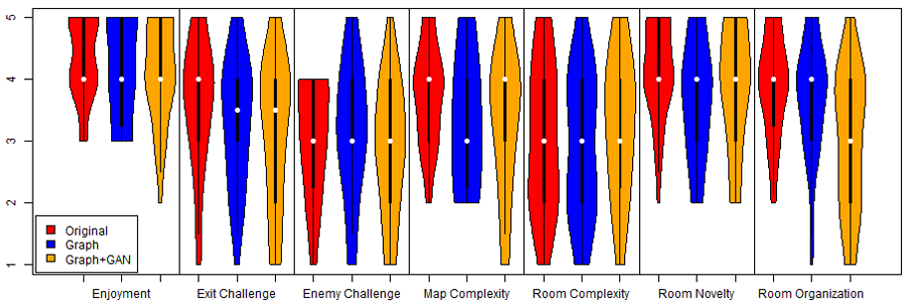
Results
Kruskal-Wallis Test
“Kruskal-Wallis tests (df = 2) indicate that there are no significant differences between dungeon types in terms of enjoyability (H = 1.5065,p = 0.4708), challenge in finding the exit (H = 2.5478,p = 0.2797), challenge from enemies (H = 1.2331,p = 0.5398), map complexity (H = 2.8105,p = 0.2453), room complexity (H = 1.2279,p = 0.5412), and room novelty (H = 4.2023,p = 0.1223).”
Only in terms of room organization is there a significant difference between dungeon types (H = 11.337,p = 0.003454), and post-hoc pairwise MannWhitney U tests with FDR error correction show that it is specifically the Graph+GAN rooms that are less organized than rooms of both Original (p = 0.0056) and Graph (p = 0.0164).”

Slide 10
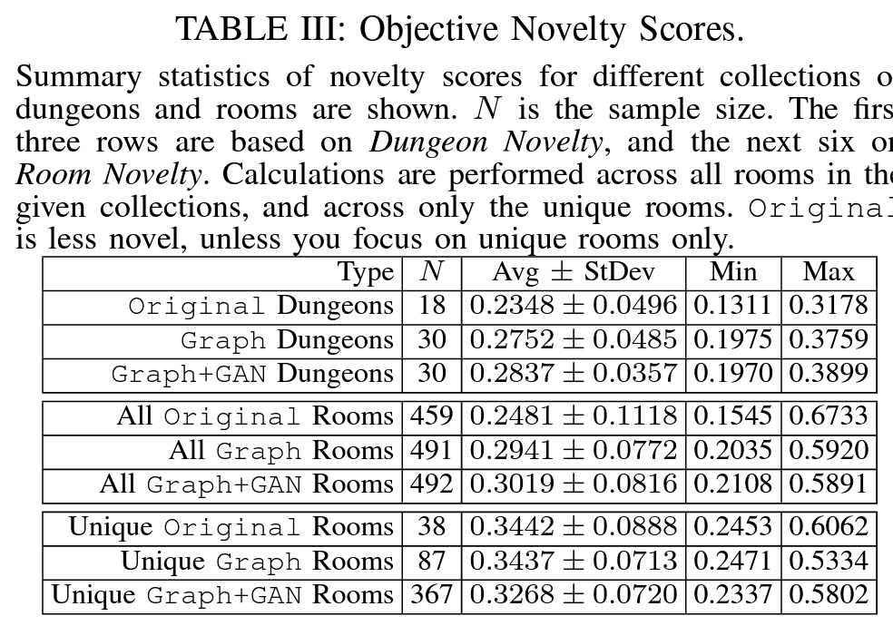
Novelty
“Comparing novelty scores of different dungeon types using one-way ANOVA reveals significant differences (F(2,75) = 7.317,p = 0.00125). Post-hoc pairwise comparisons with Tukey’s HSD and error-adjusted p-values are presented. Even though Graph only uses rooms from the original game, Graph is significantly more novel than Original (p = 0.00854). Here, Original refers to all 18 dungeons from the original game. Graph+GAN is also significantly more novel than Original (p = 0.00116), but not significantly different from Graph (p = 0.7377).”

Slide 11
Qualitative
“Quotes contextualize the quantitative findings. In particular, why was Dungeon 4-1 appealing? Participants enjoyed the water obstacle that was only passable with the raft. One said, “water cross tool/item was enjoyable.” Another said, “I liked that you had to wait later in the level to get the water walking thing and that helped you get further in the level.”
Of a Graph+GAN dungeon: “This dungeon was very chaotic, with items you didn’t need in places you couldn’t access. I liked that a lot because it threw me off and had me thinking about different possibilities.” This quote supports data indicating that GAN rooms are less organized. A participant observed: “there were parts of rooms and enemies that I couldn’t reach.”
Reachability aside, many GAN rooms simply look more chaotic: “There was a large mix of wall and water blocks, in ways that didn’t seem completely natural. There was very little symmetry and a lot of obstacles.” Although the GAN produces chaotic rooms, 10 participants specifically said things like “They seemed organized,” and “I felt like the rooms were organized.”

Slide 12
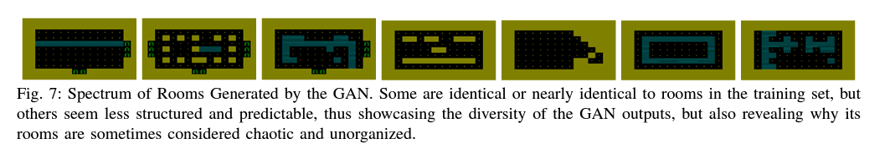
Examples

Slide 13
Conclusions

Slide 14
Conclusions
“User responses indicate that results were comparable to a handcrafted level from The Legend of Zelda.”

Slide 15
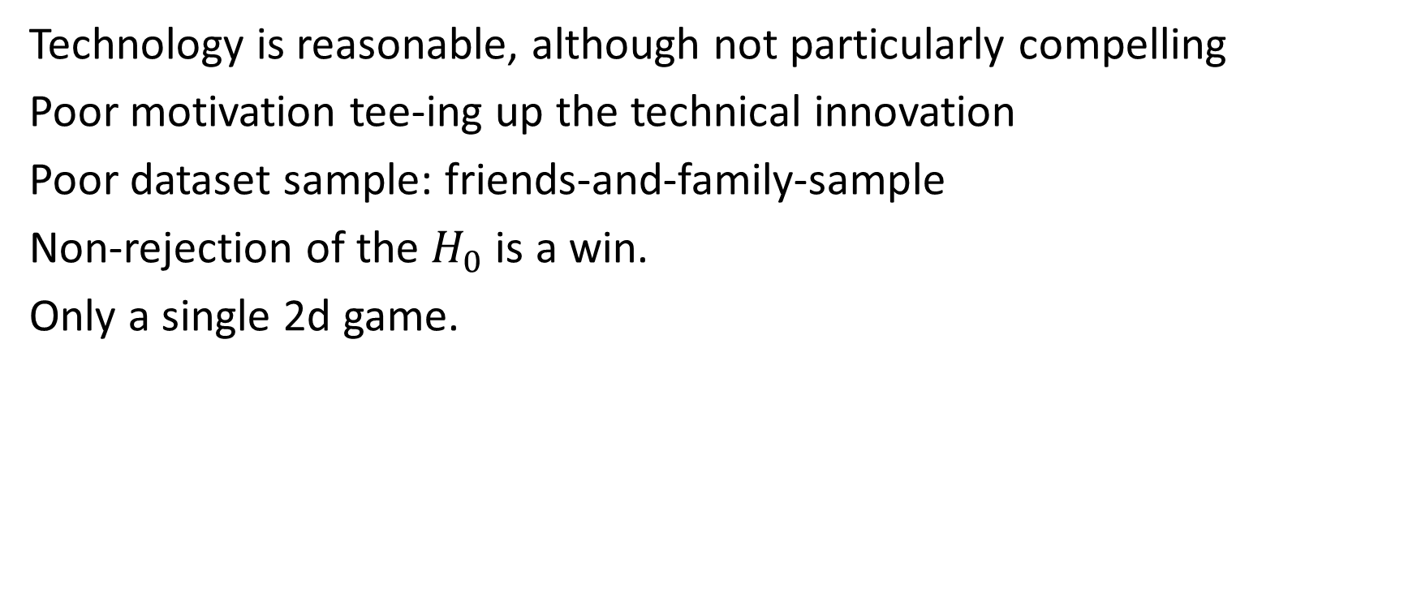
My thoughts
Technology is reasonable, although not particularly compelling
Poor motivation tee-ing up the technical innovation
Poor dataset sample: friends-and-family-sample
Non-rejection of the $H_{0}$ is a win.
Only a single 2d game.

Slide 16

Questions?

