Slide 1
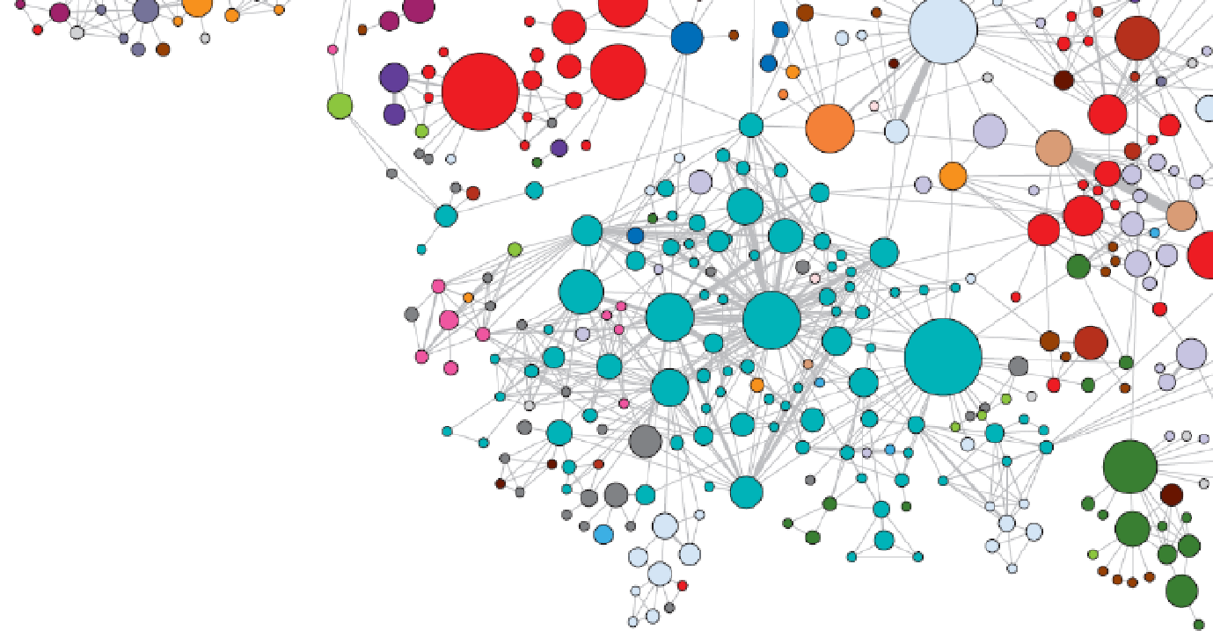
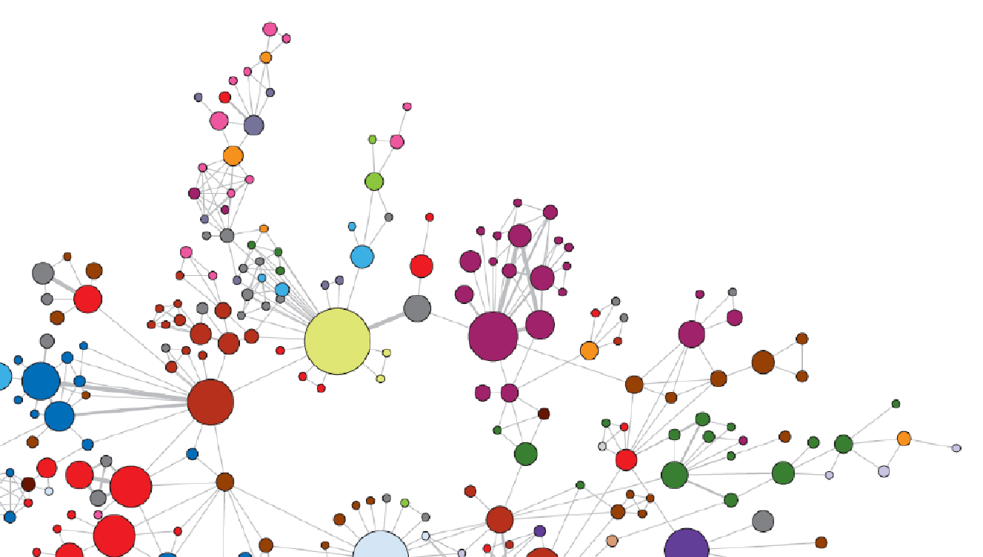
Inspectable and Respectable Heterogeneous Graph Mining Models
Tim Weninger
Frank M. Friemann Collegiate Associate Professor of Engineering

Slide 2
Introduction

Slide 3
Heterogeneous Graphs in the Wild
Conservative
Liberal
Neutral
Co-purchase Recommendations on Amazon
Co-purchase Graph of Political Books
Attributes ⇔ Topology
Notes:
Node attributes influence topology. Political homophily is at play here.

Slide 4
How to Study Graphs?
Subgraph Mining
Find and count triangles, squares, cliques, kites
Graph Representation Learning
Embed nodes in metric space
Use embeddings in DM pipelines
Graph Generative Models
Learn to model topological structures and patterns
Useful for anomaly detection, graph augmentation

Slide 5
A Brief History of Graph Generative Models
2001
Barabási-Albert
2018
NetGAN, GraphRNN
2007
Kronecker
2016
GraphAE
2020
LinearAE
2002
Chung-Lu
2011
SBM
2016
HRG
2021
AVRG
1998
Watts-Strogatz
2013
BTER
2019
CNRG, BUGGE
How to better understand graph models?

Slide 6
Graph Models 101
Erdös-Rényi
Randomly sample |E| edges independently with probability
Chung-Lu
Randomly rewire edges to approximate a target degree distribution
CNRG
Generate graphs using a learned vertex-replacement graph grammar
Kronecker
Using repeated Kronecker products, generate an adjacency matrix from a small starter matrix
Learn this starter matrix from the input data
Graph Autoencoders
Learn node embeddings with an autoencoder and inner-product decoder
Pairwise decoding of embeddings yield edge probabilities for an adjacency matrix
Notes:
missing cc label

Slide 7
The Infinity Mirror Test for Graph Models
TKDE 2021

Slide 8
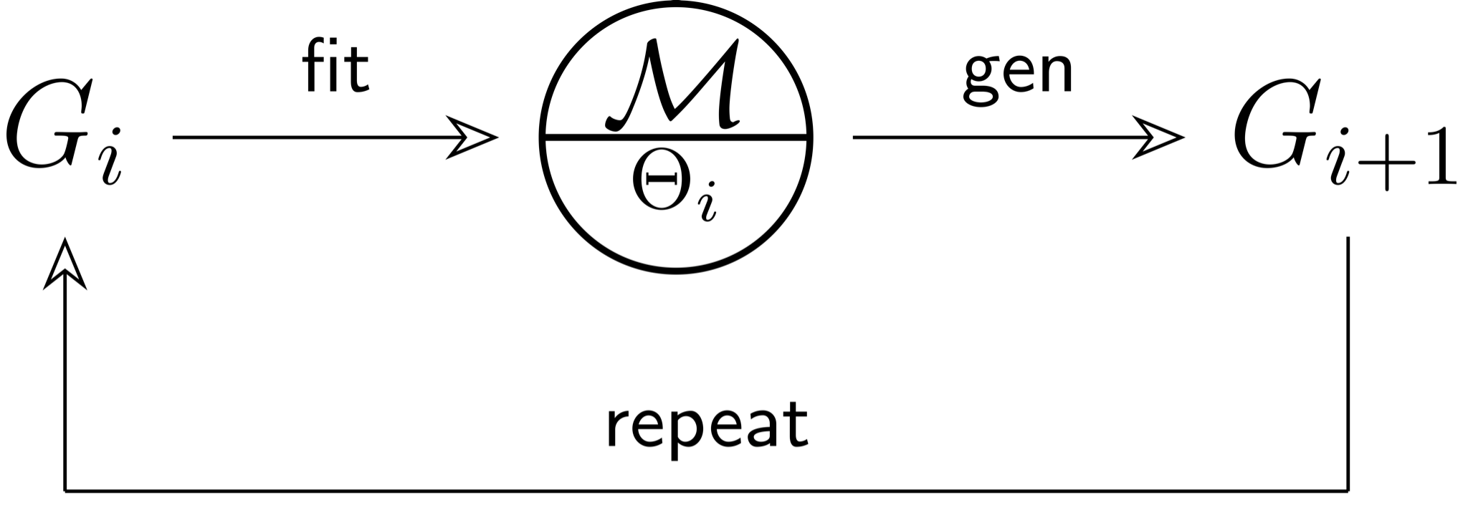
Adventures of Duck Vader and the Infinity Mirror Formalism

Slide 9
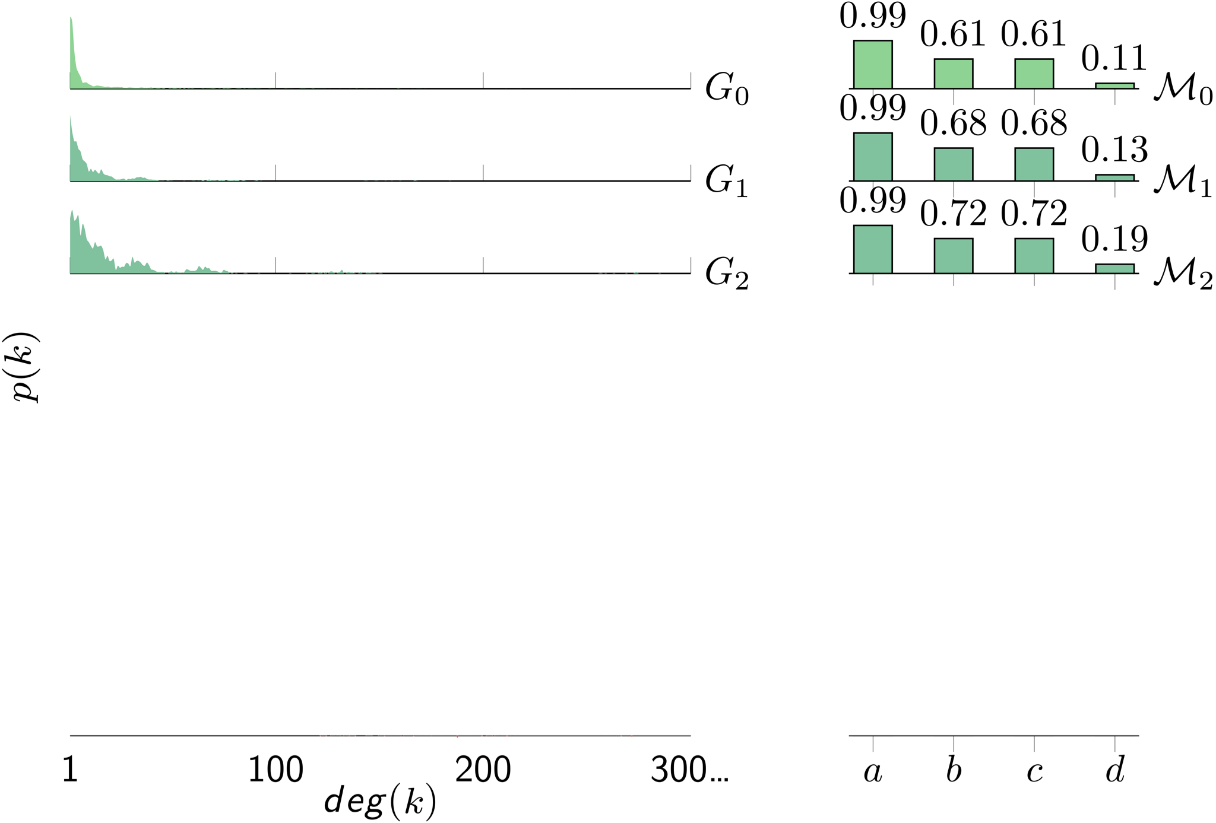
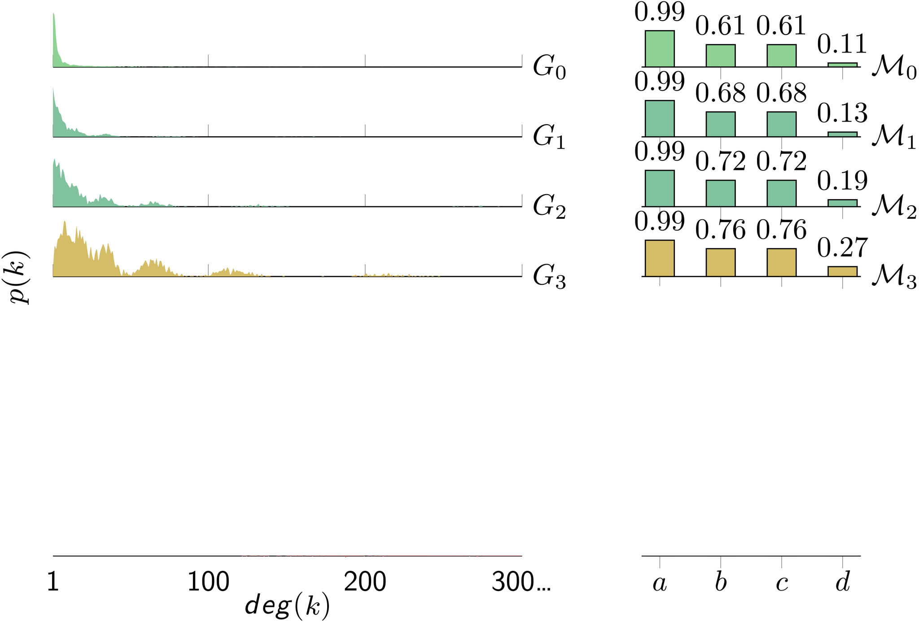
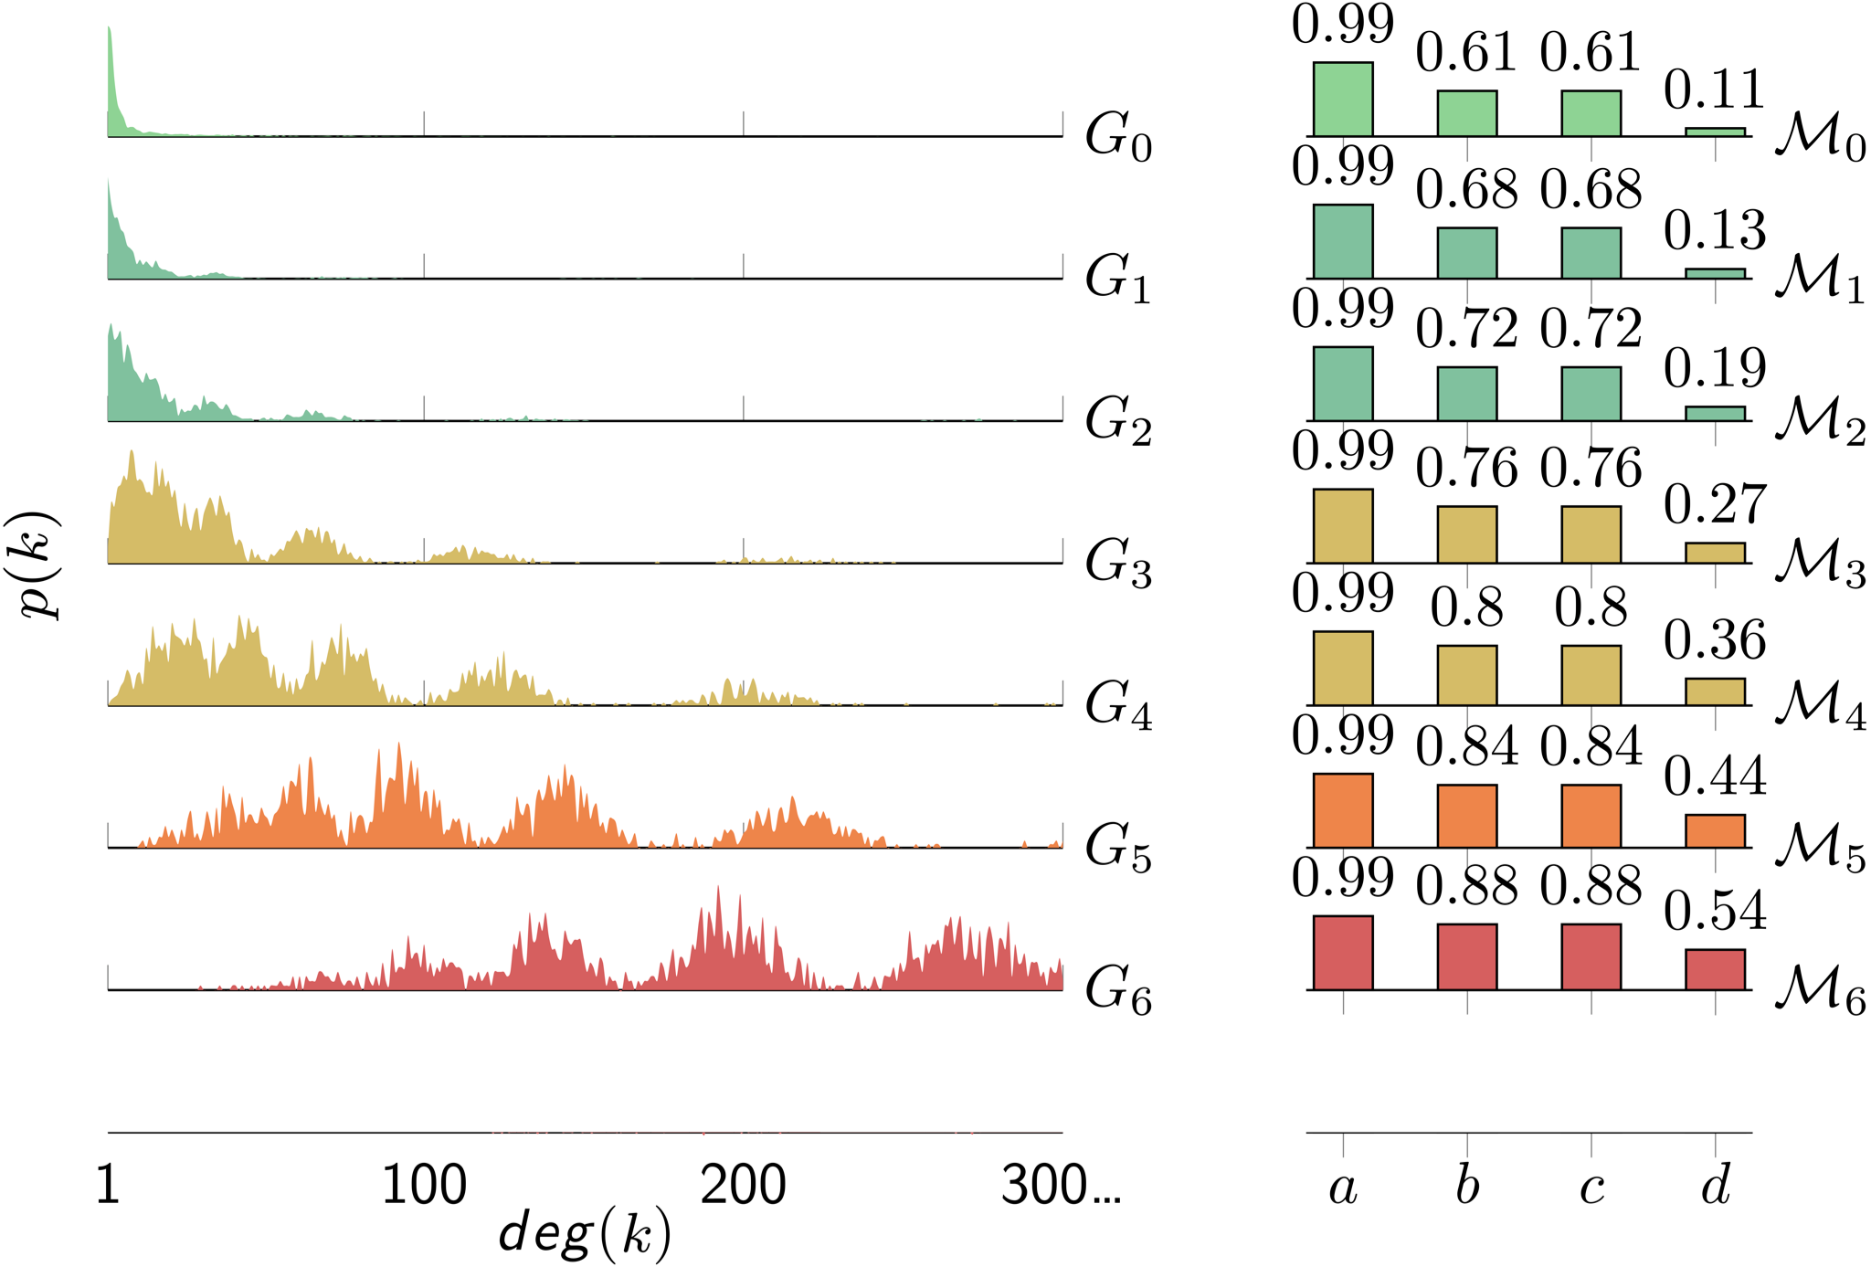
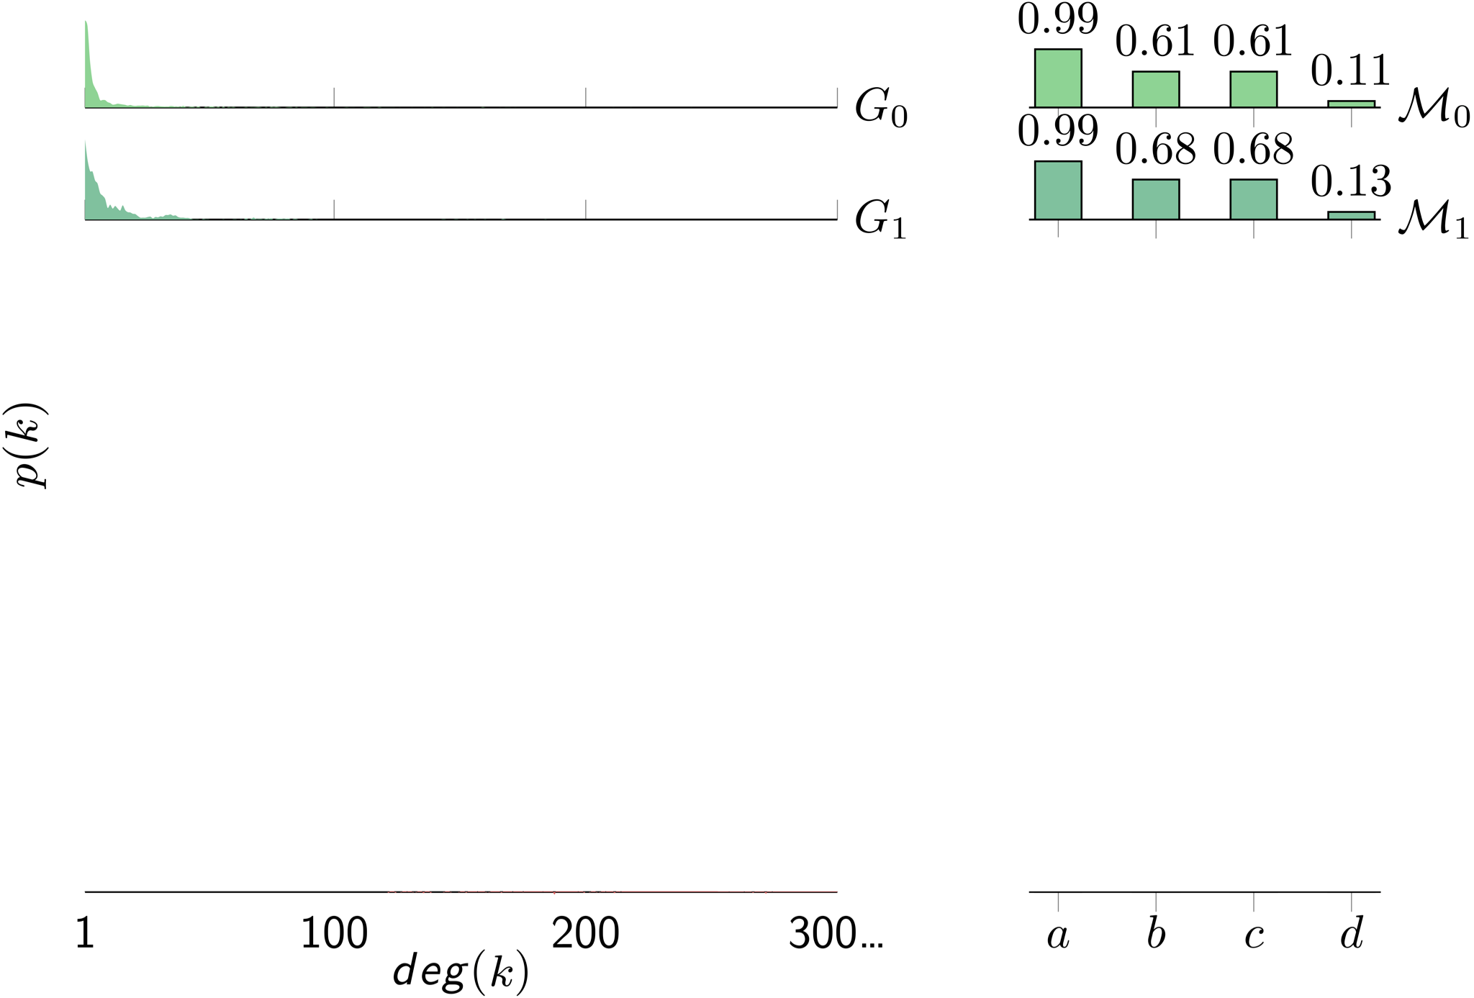
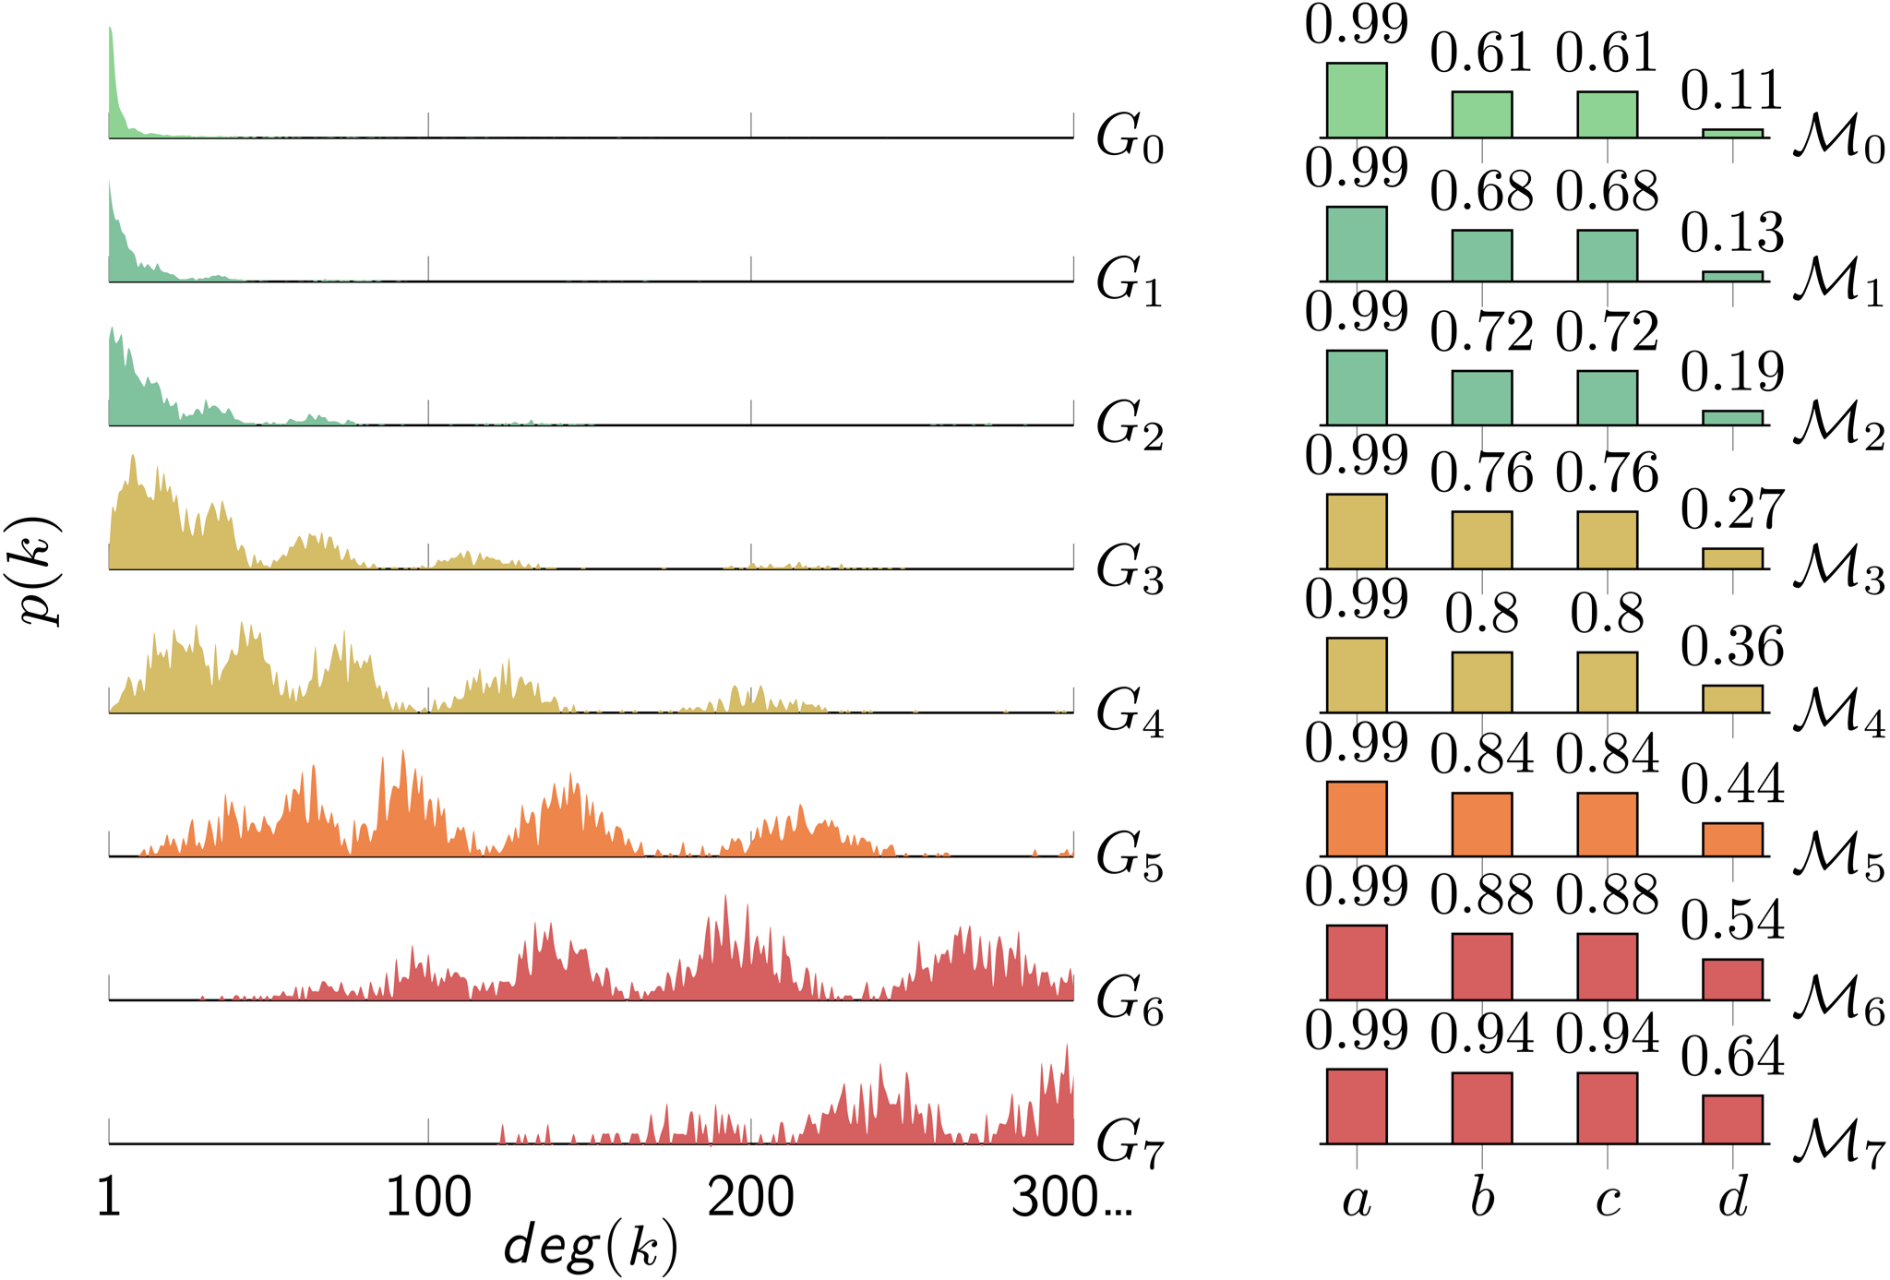
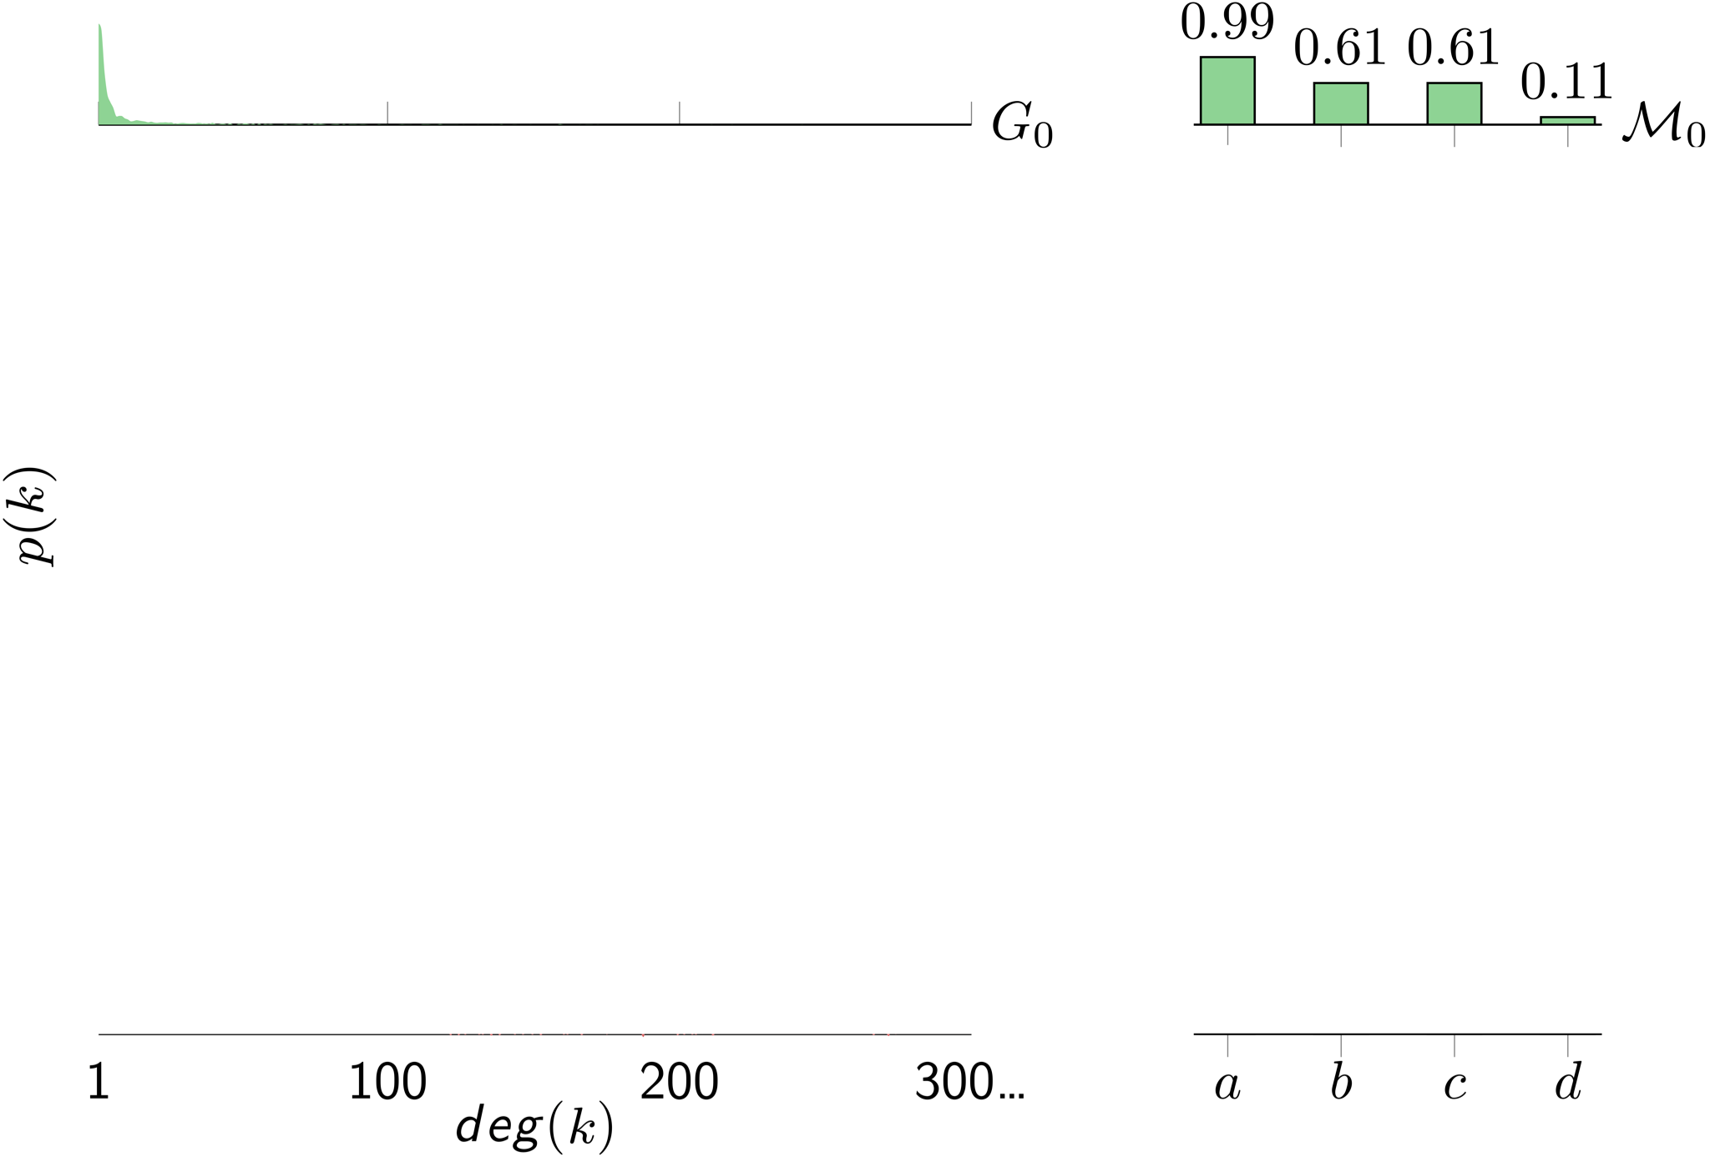
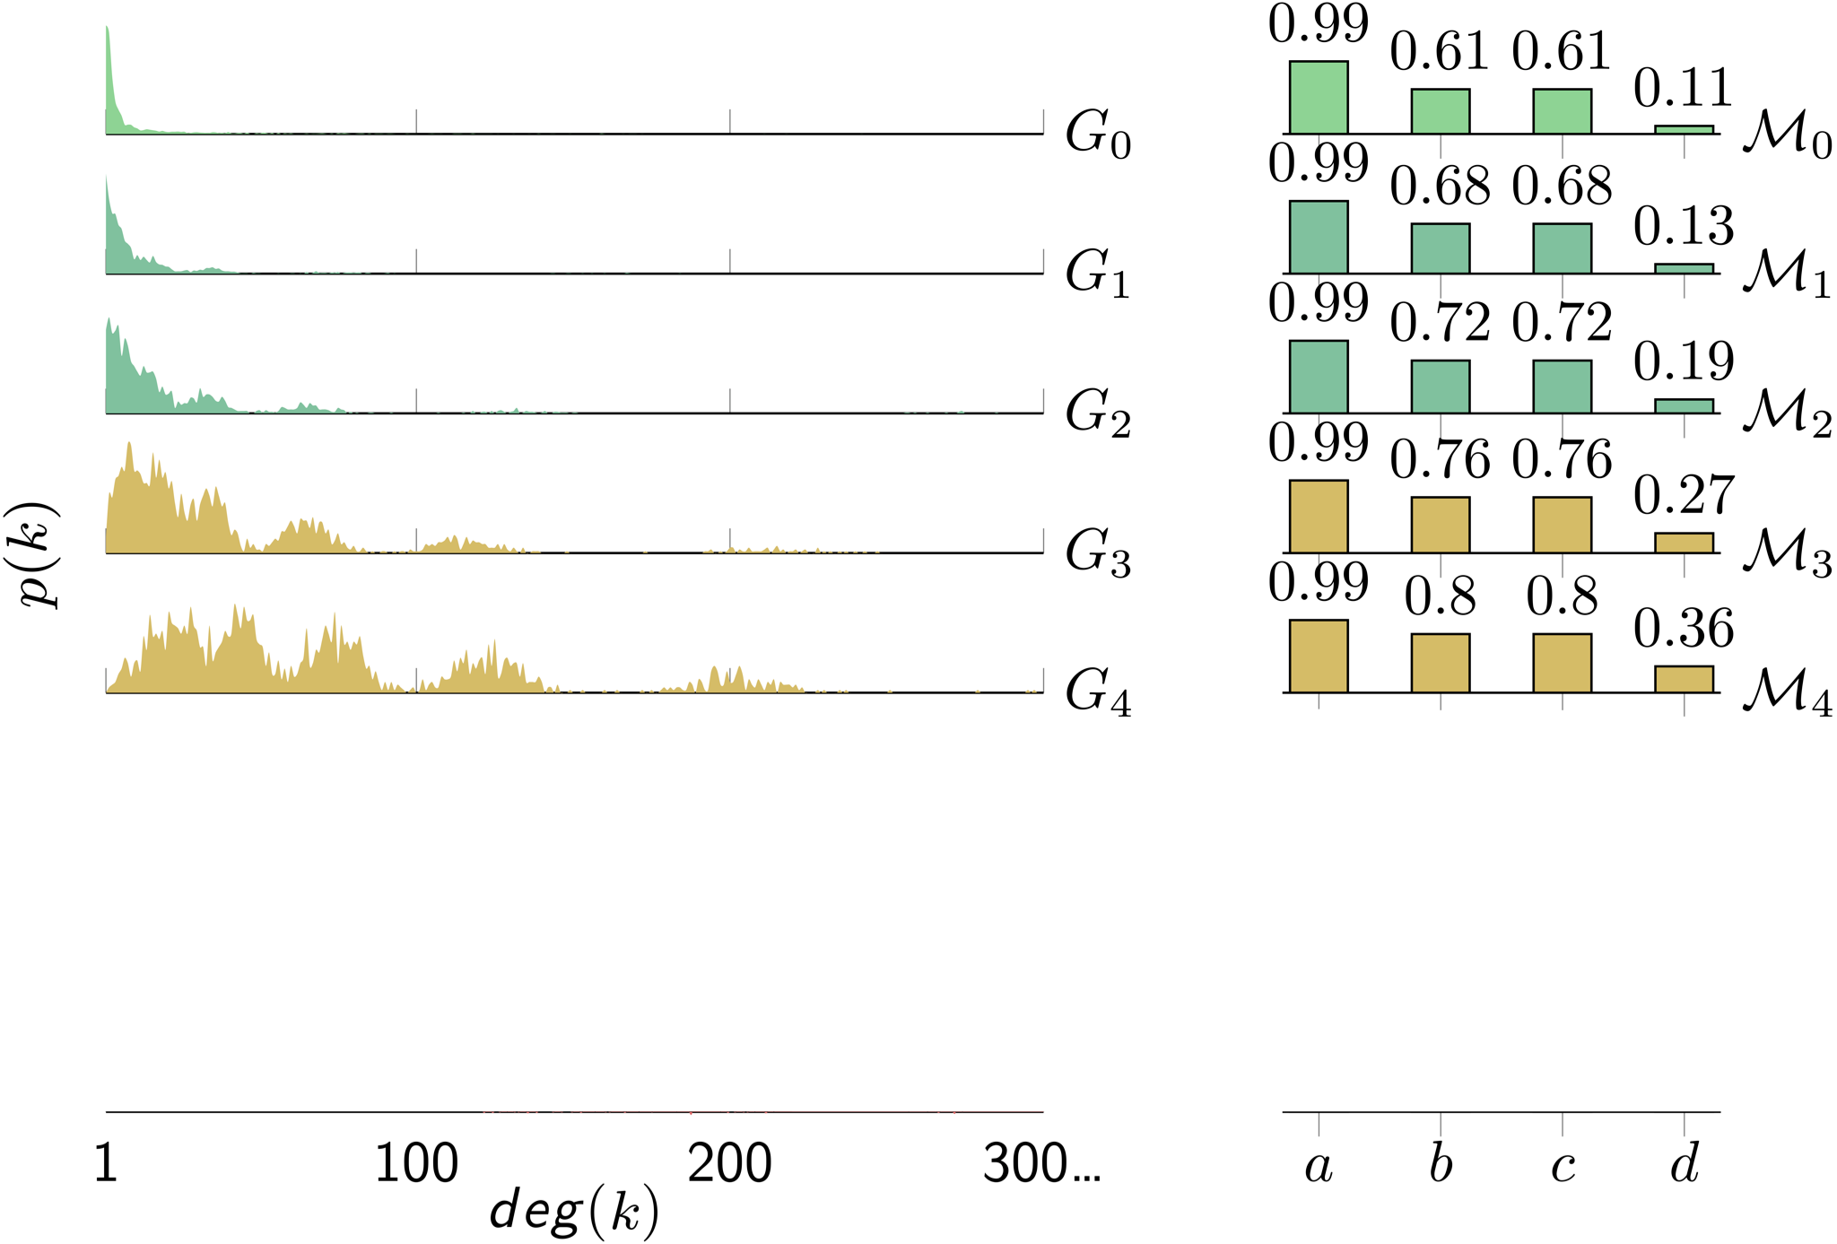
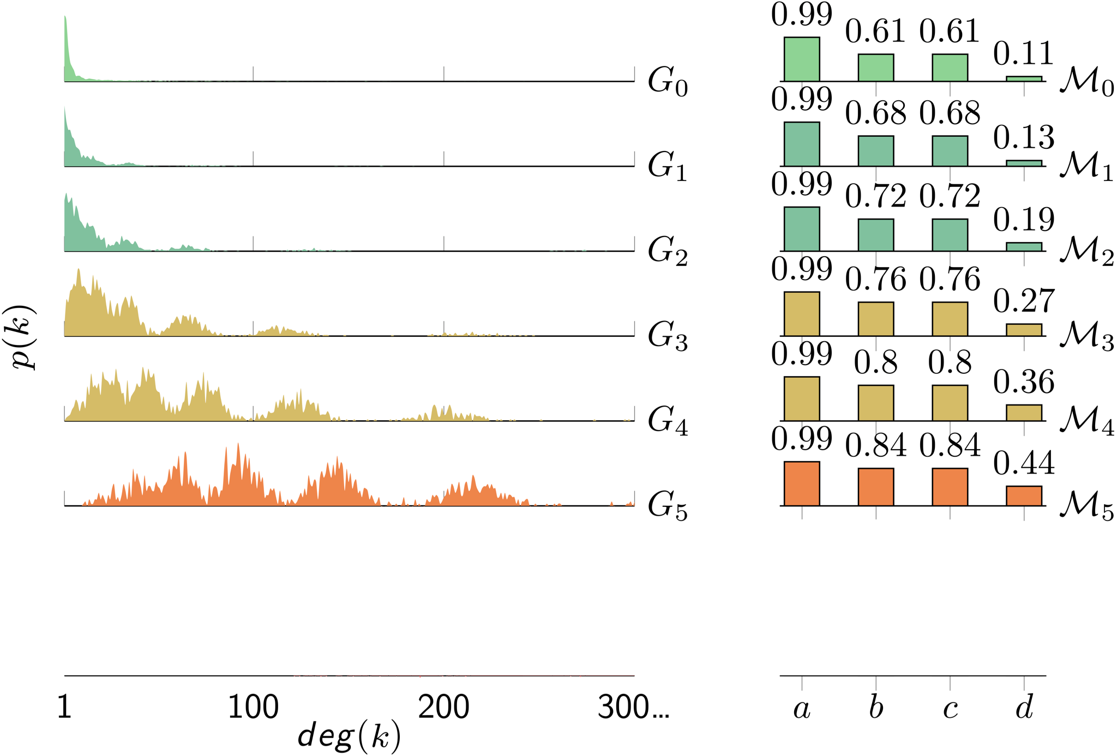
Exposing Biases of Kronecker Graphs

Slide 10
Tracking Graph Statistics over 10 Iterations
Edge Ratio
PageRank JS Divergence
Notes:
Edge Ratio:
spotlight BUGGE and Kronecker -- they degenerate predictably given the models
spotlight the GNNs -- they noticeably densify the graph (except GRNN is weird)
PageRank:
spotlight GNNs again -- they perform worse across all datasets, unlike other models

Slide 11
Tracking Graph Statistics over 10 Iterations
Portrait Divergence
Lambda Distance
Notes:
Portrait Divergence:
this is a measure of similarity between graphs computed by taking the JS distance between the two graphs’ “B Matrices”
a “B Matrix” is a matrix whose (row, col)th entry is the number of nodes at distance row from node col
again highlight BUGGE and the GNNs for underperforming across datasets
Lambda Distance:
spotlight graph autoencoders for performing badly across datasets

Slide 12
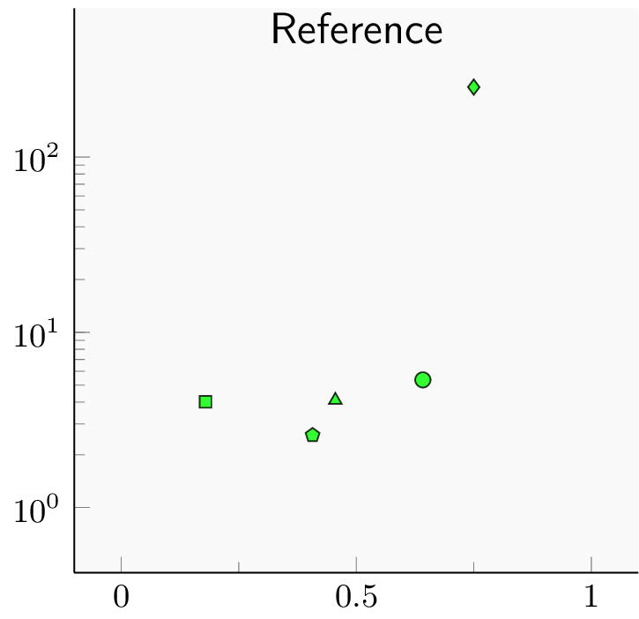
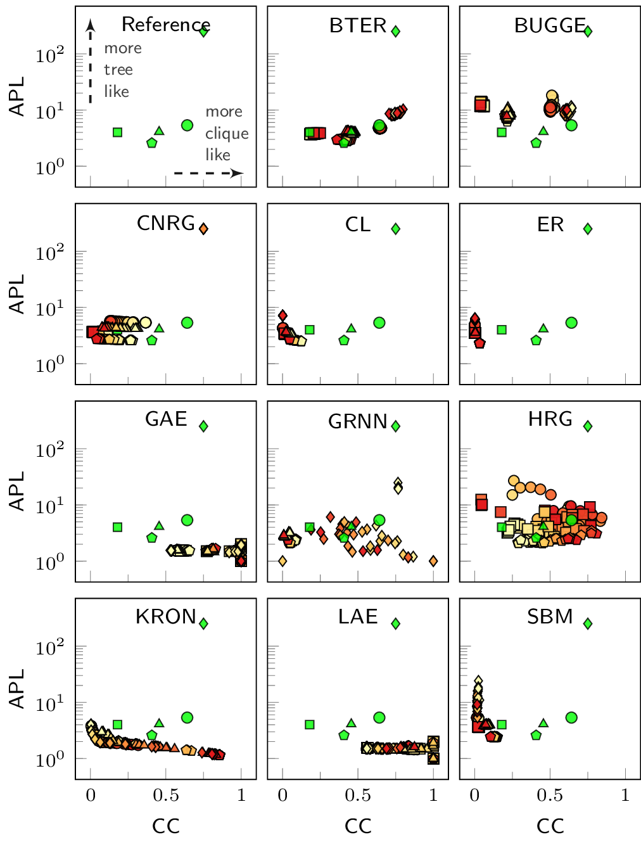
Tracking Evolution of Graphs - Clustering and Path Lengths
more
tree
like
Clique Ring
Average Path Length
more clique like
Average Clustering
Notes:
missing cc label

Slide 13
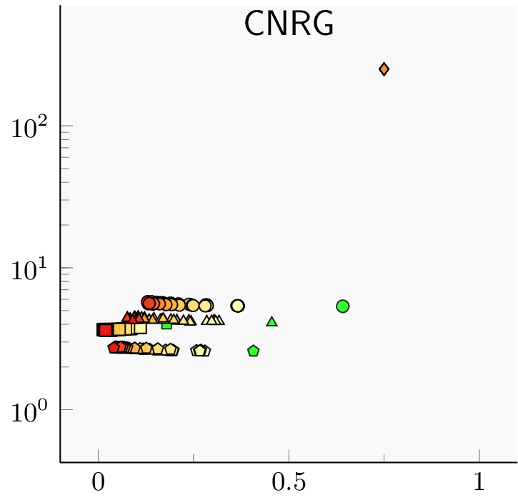
Tracking Evolution of Graphs - Clustering and Path Lengths
Perfect overlap
Average Path Length
Cliques start to contract
Average Clustering
Notes:
missing cc label

Slide 14
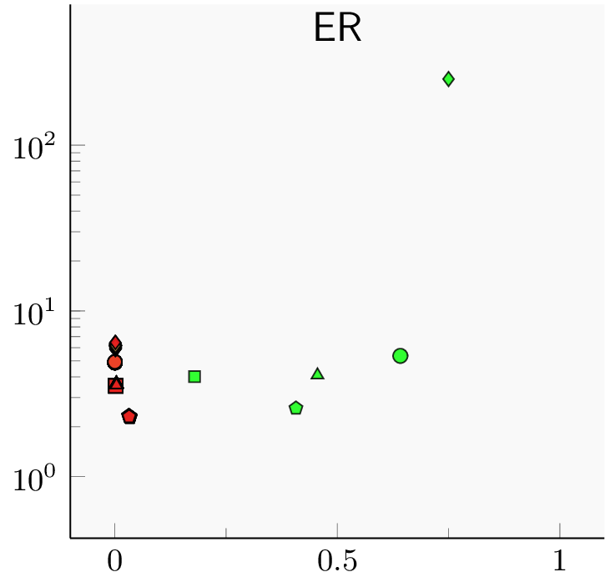
Tracking Evolution of Graphs - Clustering and Path Lengths
very low clustering
Average Path Length
Average Clustering
Notes:
missing cc label

Slide 15
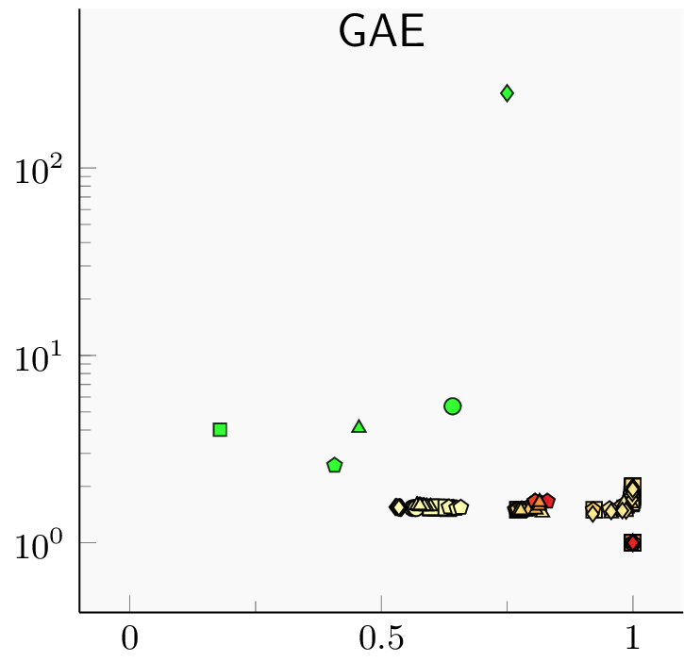
Tracking Evolution of Graphs - Clustering and Path Lengths
Average Path Length
Graphs get really dense
Average Clustering
Notes:
missing cc label

Slide 16
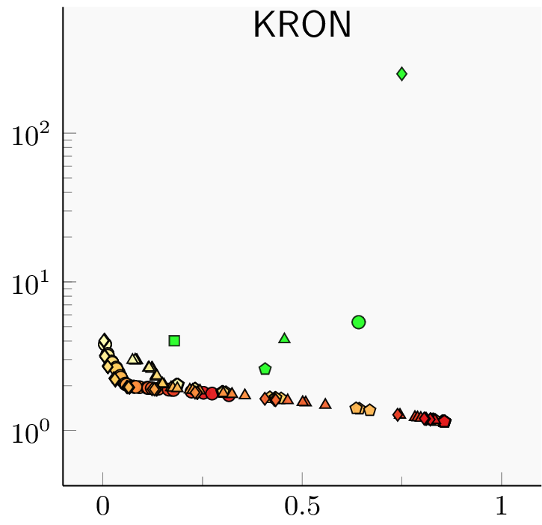
Tracking Evolution of Graphs - Clustering and Path Lengths
increasing edge density
Average Path Length
Average Clustering
Notes:
missing cc label

Slide 17
Main Takeaways
ER graphs have almost no clustering
Edge probability p is very small
Kronecker densifies the graphs slowly
The initiator matrix grows monotonically
Autoencoders
Decoder creates dense matrices => dense graphs
Grammar based models work well
Interpretable and powerful
Why? How?
We need interpretable graph models
Notes:
missing cc label

Slide 18
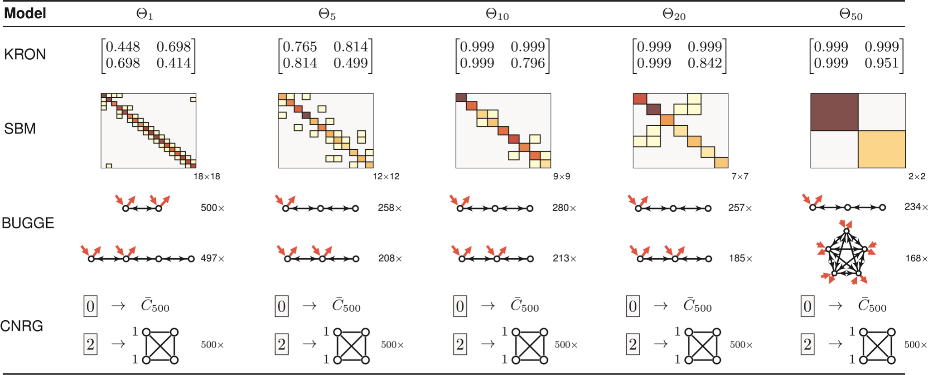
How to Stress-test Graph Models?

Slide 19
Modeling Attributed Graphs with
Vertex Replacement Grammars

Slide 20
Context-free String Grammars
Production Rules
Derivation of “bbebee”
Parse Tree
Generalize beyond strings
Learn production rules from graphs
Principled, interpretable mining on attributed graphs
Production Rules
Learning Production Rules
Parse Tree
Notes:
Phase 1: Generating strings from a given string grammar
Phase 2: Extracting grammar rules from observed strings

Slide 21
Attributed Graph Grammars
Example Attributed Graph
Attributed Graph Grammar

Slide 22
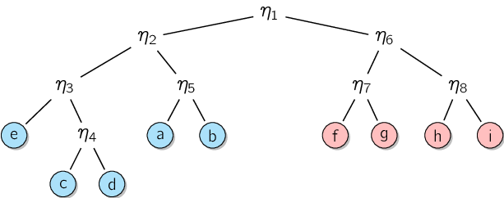
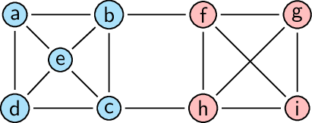
Hierarchical Graph Clustering
Louvain
Leiden
METIS
MinCut
Toy Attributed Graph
Example Dendrogram

Slide 23
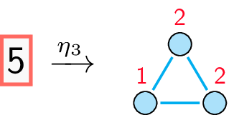
Grammar Rule Extraction (μ = 3)
Current Dendrogram
Current Graph
Extracted Grammar Rule

Slide 24
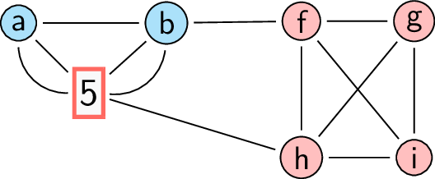
Grammar Rule Extraction (μ = 3)
Updated Dendrogram
Updated Graph
Extracted Grammar Rule

Slide 25
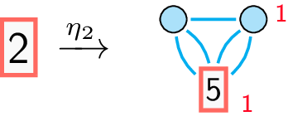
Grammar Rule Extraction (μ = 3)
Current Dendrogram
Current Graph
Extracted Grammar Rule

Slide 26
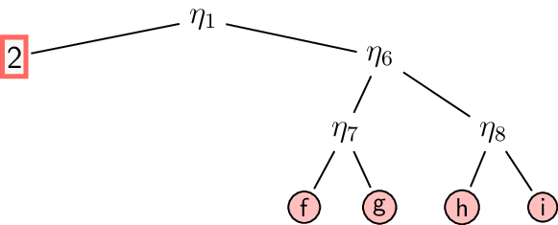
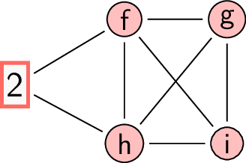
Grammar Extraction (μ = 3)
Updated Dendrogram
Updated Graph
Extracted Grammar Rule

Slide 27
Grammar Extraction (μ = 3)
Current Dendrogram
Current Graph
Extracted Grammar Rule

Slide 28
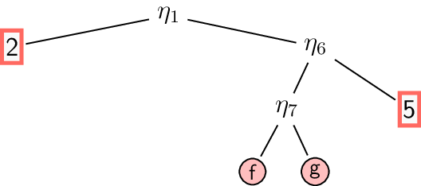
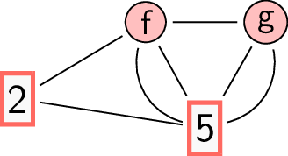
Grammar Extraction (μ = 3)
Updated Dendrogram
Updated Graph
Extracted Grammar Rule

Slide 29
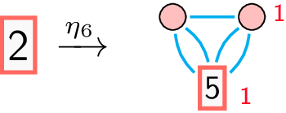
Grammar Extraction (μ = 3)
Current Dendrogram
Current Graph
Extracted Grammar Rule

Slide 30
Grammar Extraction (μ = 3)
Updated Dendrogram
Updated Graph
Extracted Grammar Rule

Slide 31
Grammar Extraction (μ = 3)
Current Dendrogram
Current Graph
Extracted Grammar Rule

Slide 32
Grammar Extraction (μ = 3)
STOP!
Updated Dendrogram
Updated Graph

Slide 33
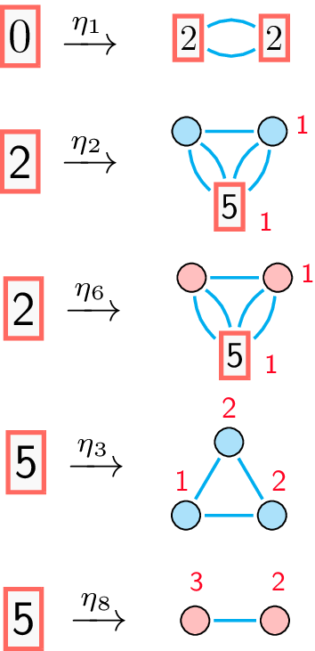
Extracted Grammar Rules
Input Graph
Dendrogram
Extracted Grammar Rules

Slide 34
Attributed Graph Generation
Current Graph
Next Graph

Slide 35
Attributed Graph Generation
Current Graph
Next Graph

Slide 36
Attributed Graph Generation
Current Graph
Next Graph

Slide 37
Attributed Graph Generation
Current Graph
Next Graph

Slide 38
Attributed Graph Generation
STOP!
Current Graph
Next Graph

Slide 39
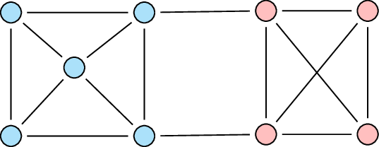
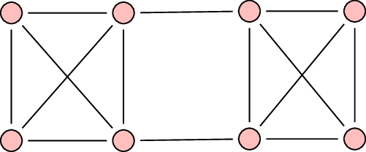
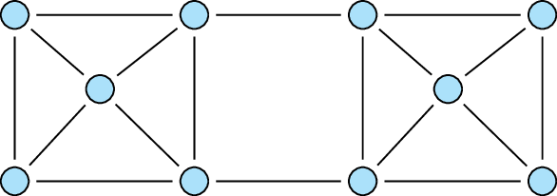
Attributed Graph Generation
Probability = ½
Probability = ¼
Probability = ¼

Slide 40
Real-world Grammars - Cora Citation Network
Papers are divided into 7 classes
Strong Homophily
6 most frequent grammar rule RHS

Slide 41
Takeaways
Graph grammars are both powerful and interpretable
Individual rules describe the building blocks
Provides an unique insight into the network
Exciting direction but lots of open questions
Knowledge graph completion
Temporal graph generation
Hypergraphs
Reinforcement learning

Slide 42
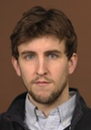
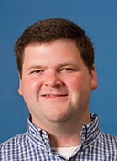
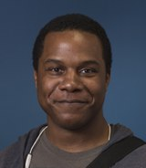
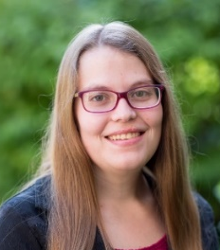
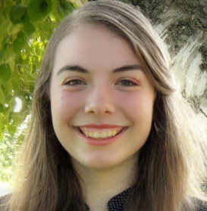
Rockstars
University of Louisville
LinkedIn
Northwestern University
Cal Poly
Pacific Northwest National Lab
University of Notre Dame
Rose Hulman Inst. of Tech.
Indiana University
Current Students
Special Thanks To:

Slide 43
Thank you!
(tweninger@nd.edu)

