Slide 1

Fact, Fiction, and the Newsfeed
Artificial Promotion in the Attention Economy
Tim Weninger
Associate Professor
Computer Science and Engineering

Slide 2
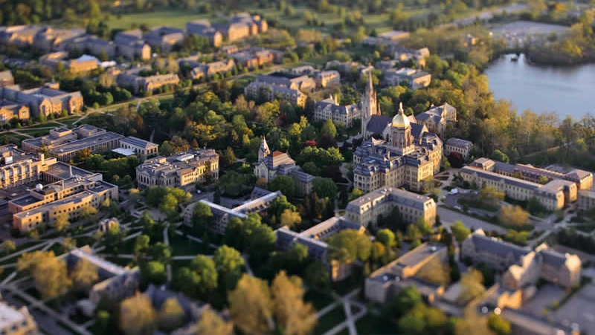
Artificial Promotion in the Attention Economy

Slide 3
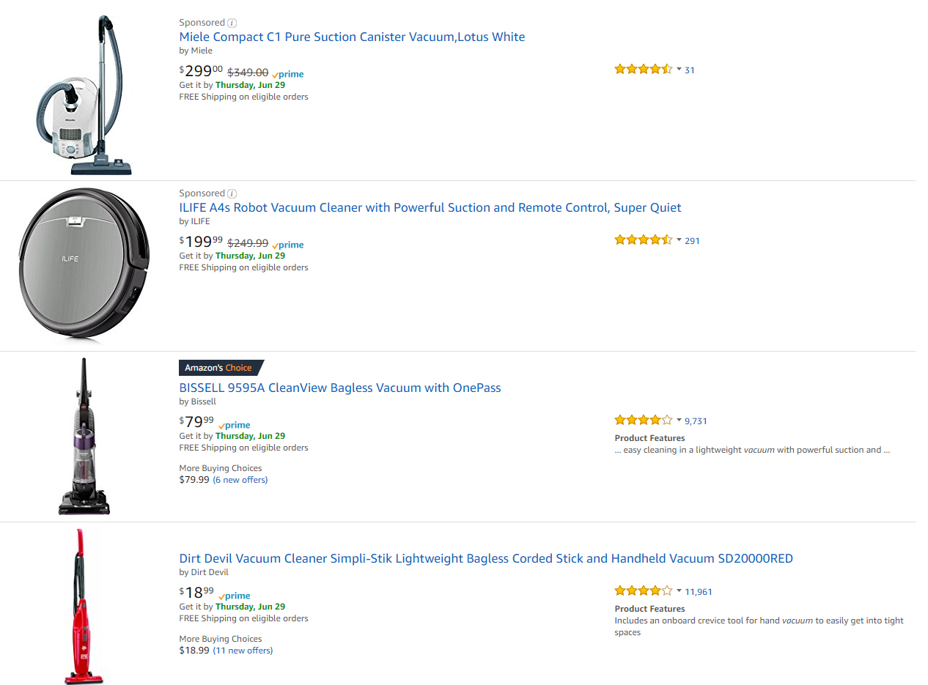
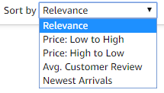
User Ratings and the Perception of Quality

Slide 4


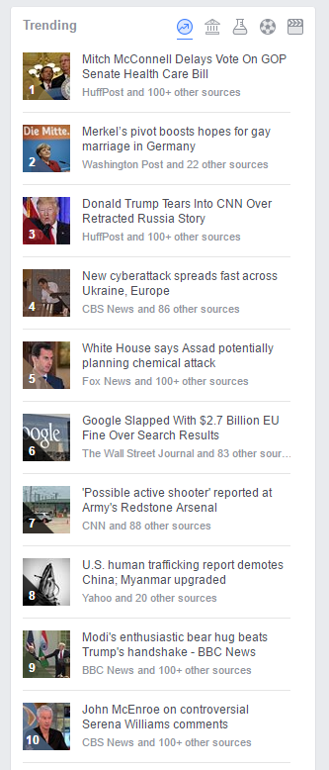

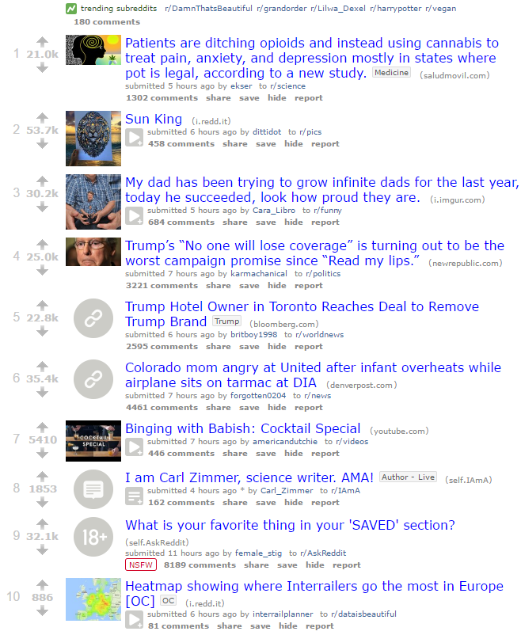
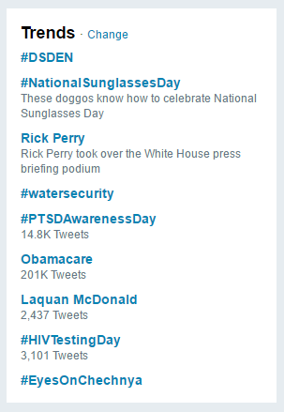
User Ratings and the Perception of Quality

Slide 5
Manipulation of Social News
Manipulation of Social News
Weninger Oct 21, 2013

Slide 6
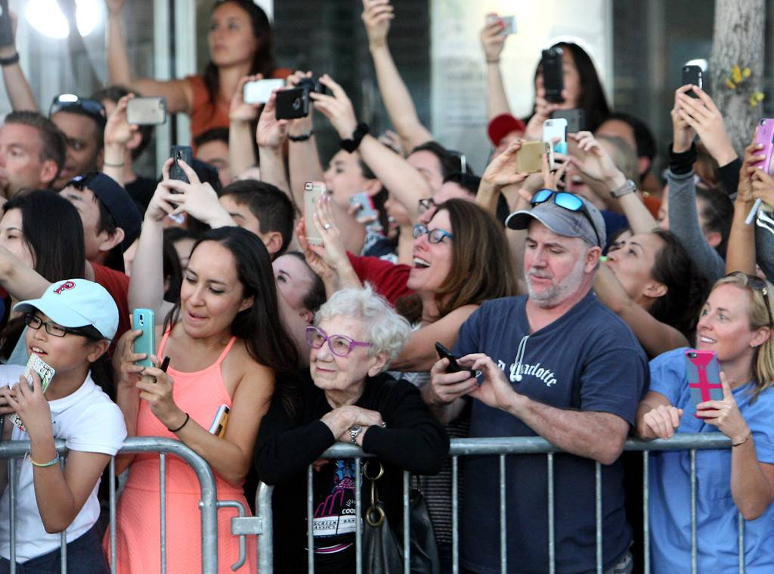
Social News Manipulation:
On the Creation and Spread of Misinformation

Slide 7
Vote Injection
Randomized in-vivo experiment:
Upvote, downvote, or nothing-vote newest Reddit post
Every two minutes
For 4 months
Resulting in 93,000 total vote injections

Slide 8
Vote Injection – a single vote
Posts
Comments

Slide 9
Vote Injection - Popularity Probability
Posts
Comments

Slide 10
Why?
Consistent theory beginning to emerge:
Visibility Bias – accumulated advantage, rich-get-richer, Matthew effect
For to everyone who has will more be given, and he will have an abundance.
Matthew 25:29

Slide 11
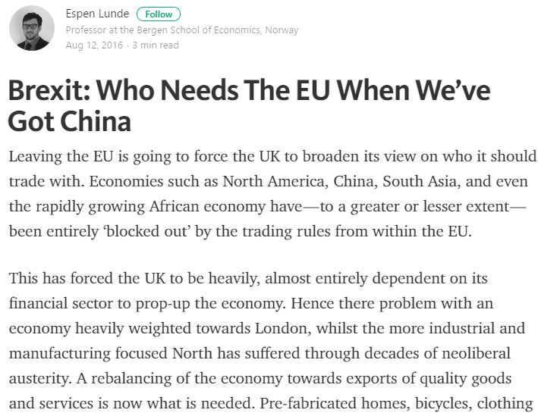
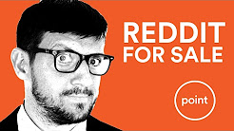
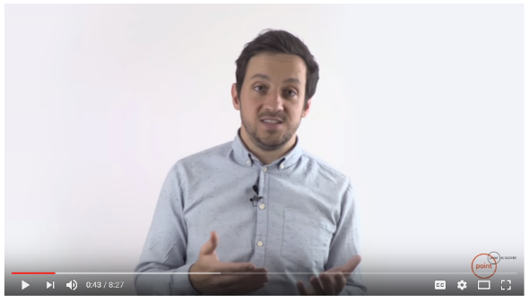
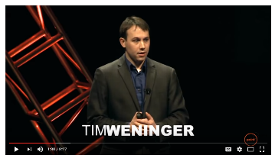
How easy is it?

Slide 12
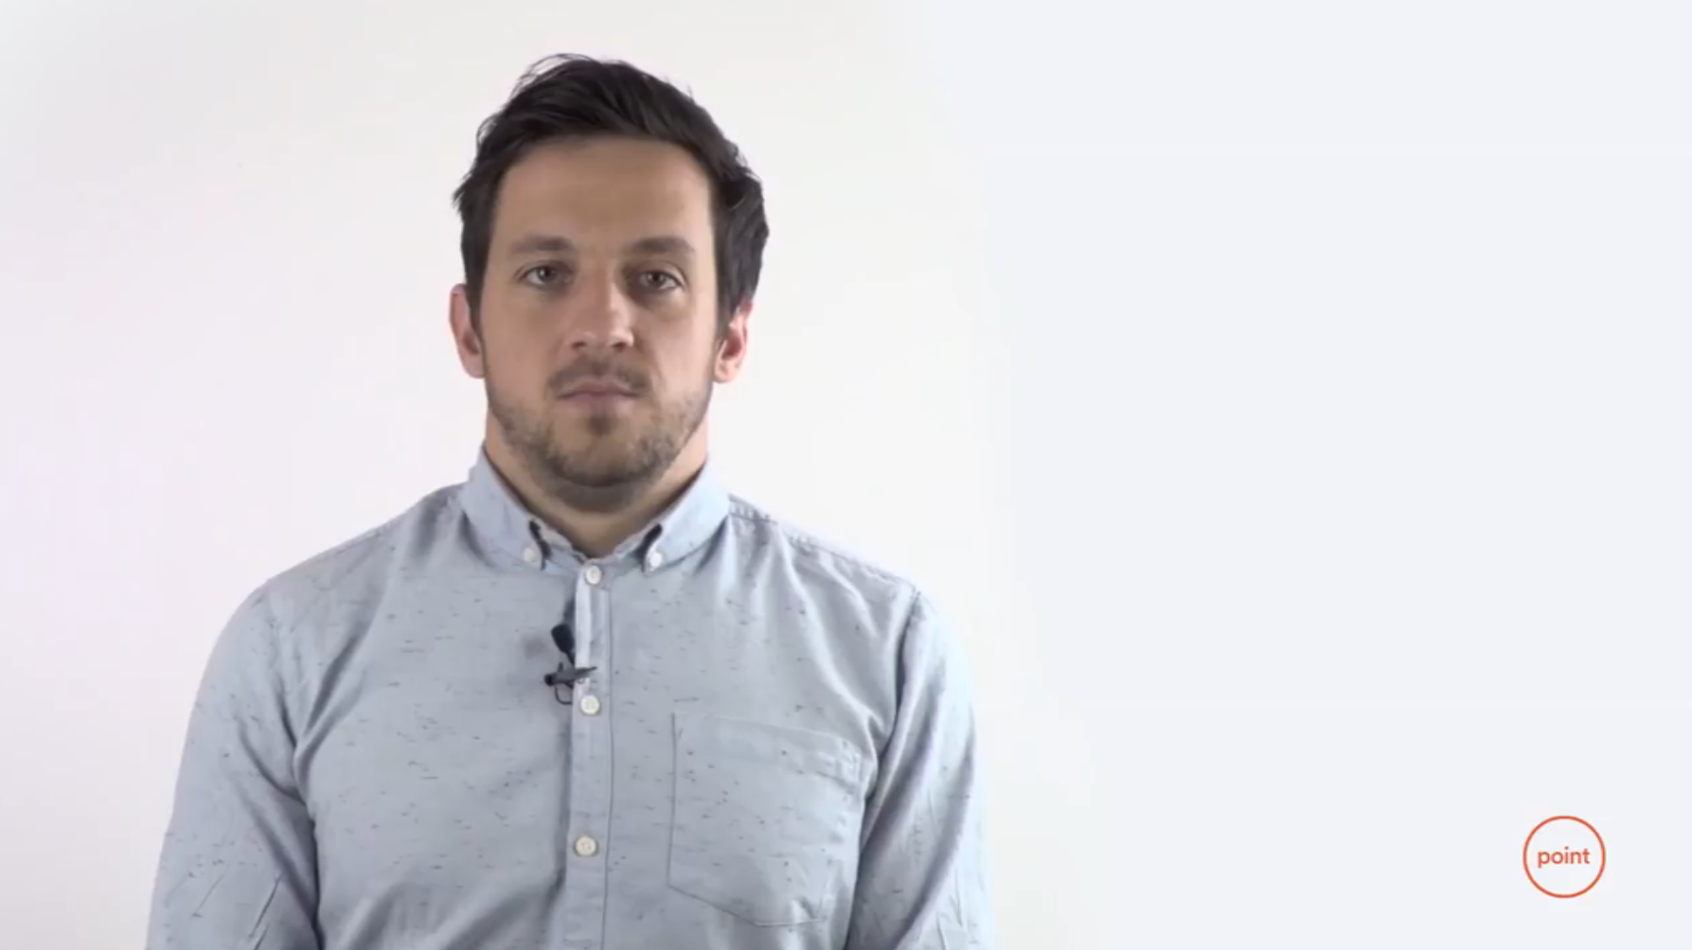

Slide 13
Popularity vs Preference
Does social media show its users content they want to see?
Do social voting systems work?

Slide 14
GuessTheKarma – a social rating experiment

Slide 15
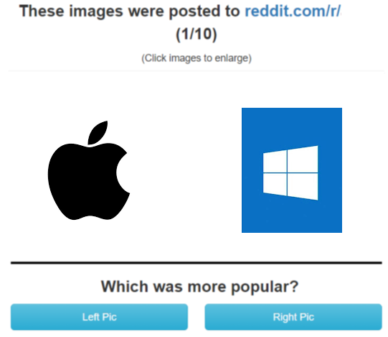
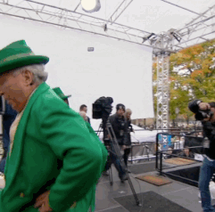
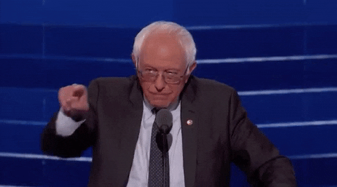
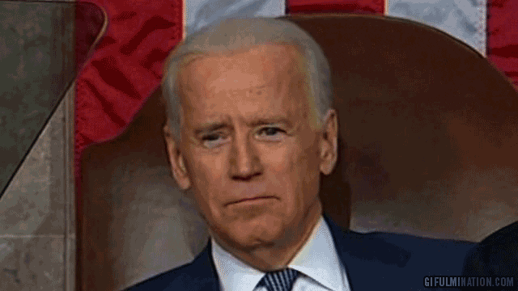
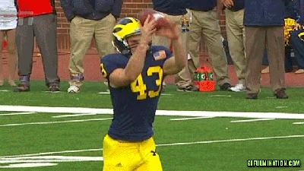
GuessTheKarma – a social rating experiment

Slide 16
How well did people do?
Random guessing: 50% accuracy
Results: 52% accuracy

Slide 17
Reddit experts – are they better guessers?
We asked how much each judge used Reddit:
  63 people answered yes to all questions (superusers)
  122 answered no to all questions (non-users)
  Heavy users were no more accurate than non-users
What does this mean?
(Almost) No relationship between a what people want to see
and what they actually see on social media

Slide 18
So what now? What can we do?
Understand why these problems persist on social media.

Slide 19
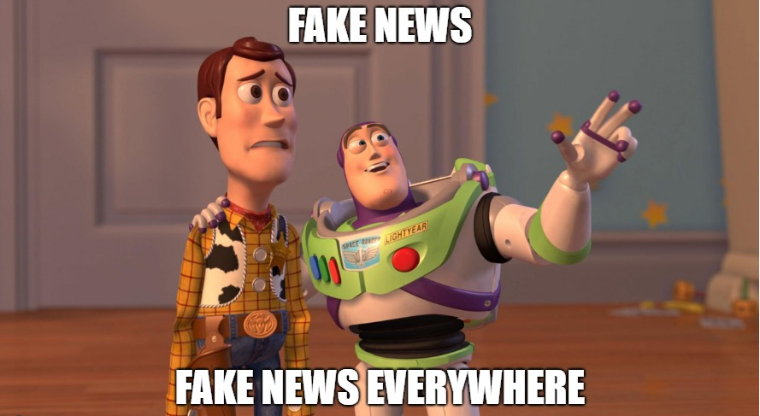
Spread of misinformation:
Its all our fault

Slide 20
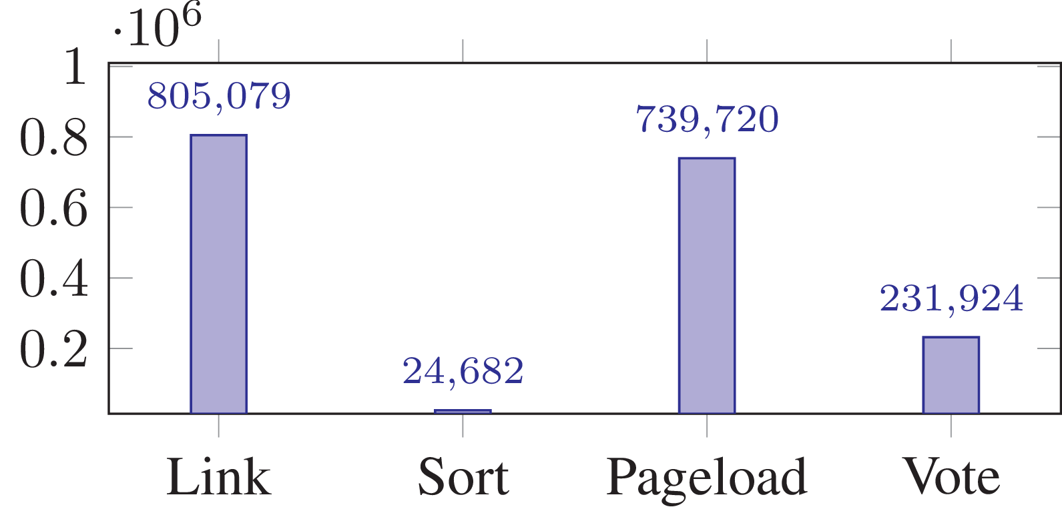

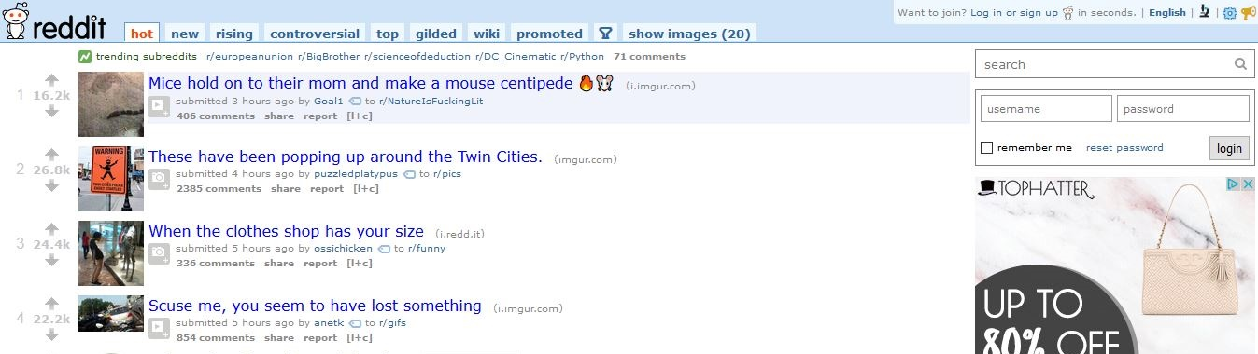
Voting Patterns
309 users
1,801,405 votes and clicks

Slide 21
Most people don’t vote
Headline Browsers:
Most people don’t click on anything
Most people don’t vote

Slide 22
Most people don’t read before they vote, like, or share
74% of votes occurred without the user ever viewing the post.

Slide 23
Most people don’t read most things
Visibility bias is huge
7% of clicks went to top post,
<0.1% went to #25

Slide 24

So what now?
Tim’s incomplete list of things that won’t help:
- Fact Checking
- Censorship
- Shaming

Slide 25
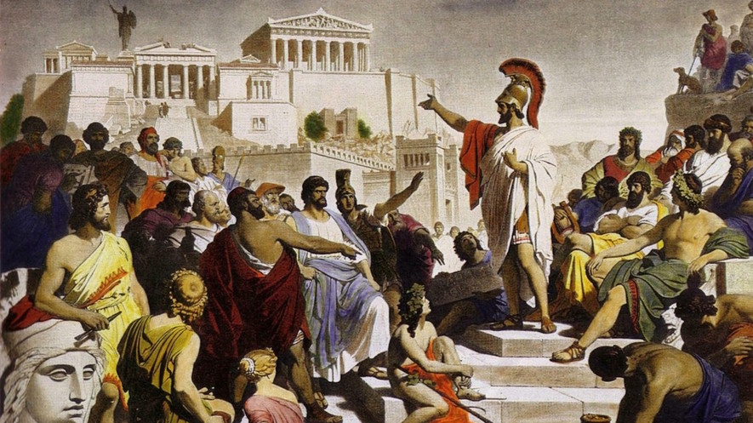
What is Notre Dame doing to fix things?

Slide 26
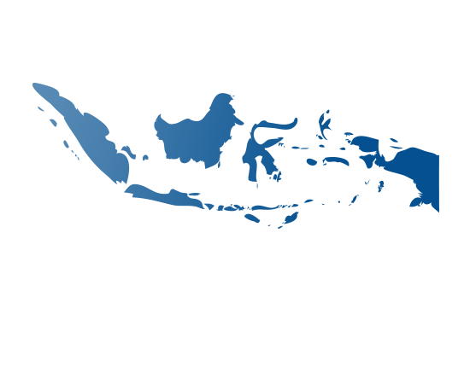
Research Question
Media Literacy!
If we provide customized online media literacy content to segmented audiences of new digital arrivals, then the recipients of media literacy will be less likely to engage with and spread misinformation.
Context:
Indonesia

Slide 27
Tasks:
Identify vectors of misinformation
Adapt media literacy to social media
Deploy Media Literacy Campaigns
Measure effectiveness and continuously optimize

Slide 28

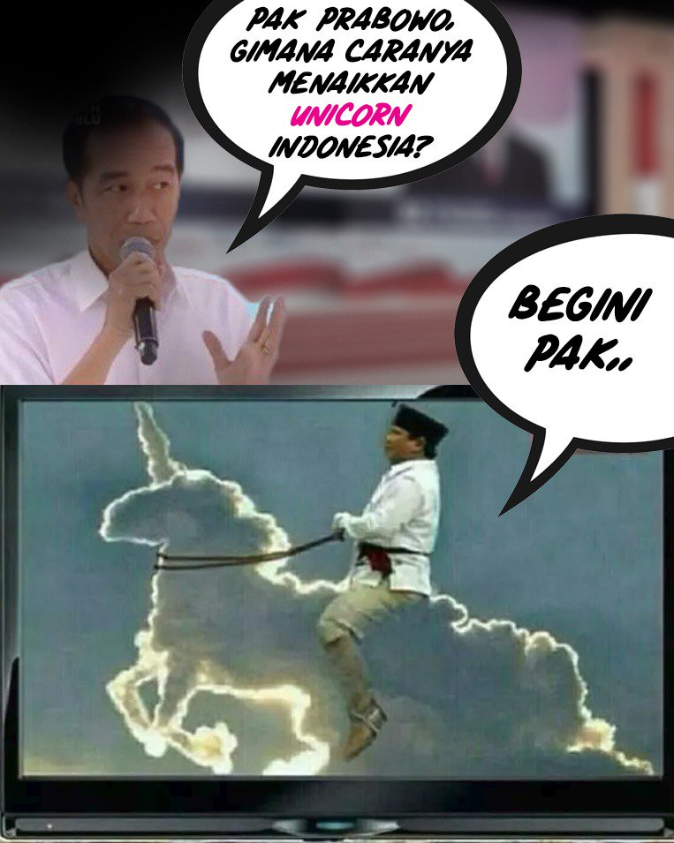

Indonesian Presidential Elections

Slide 29
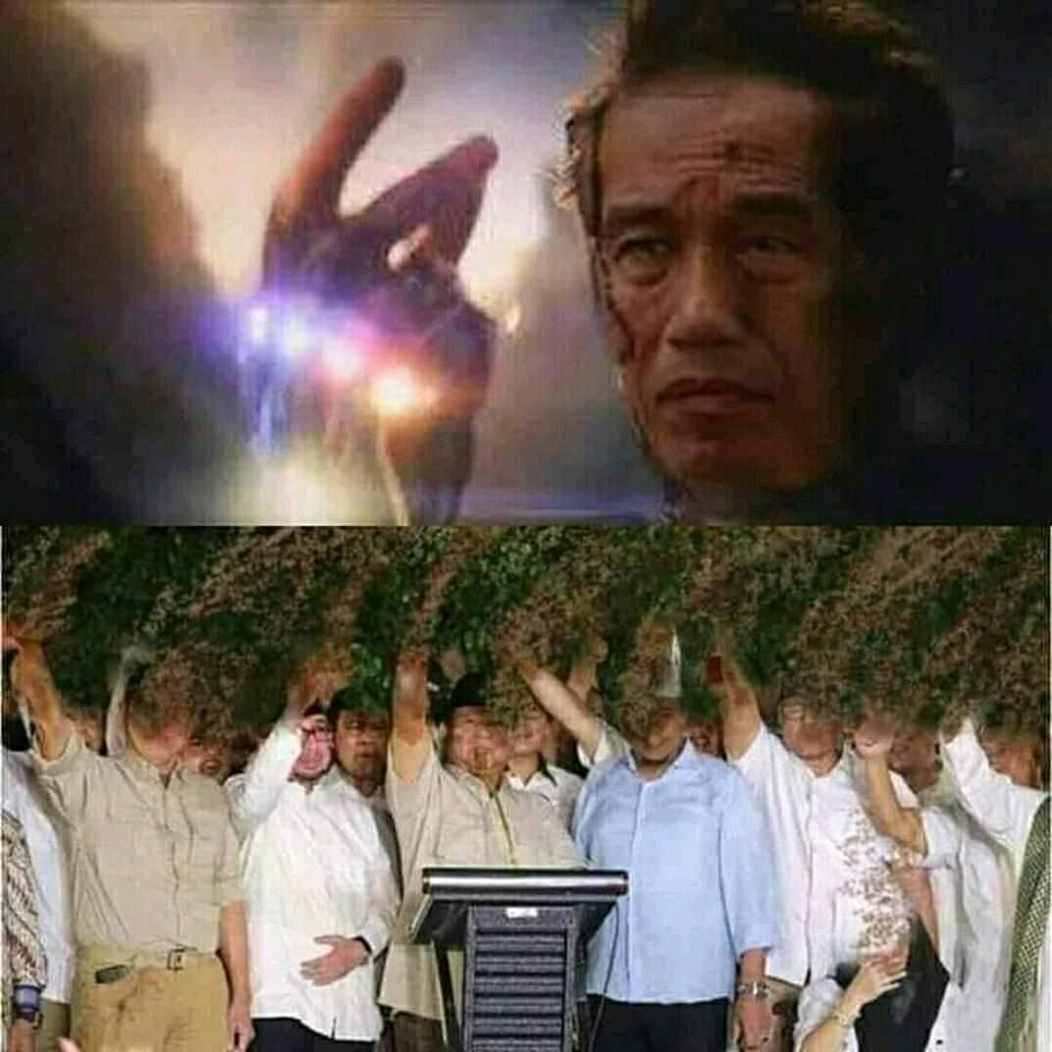
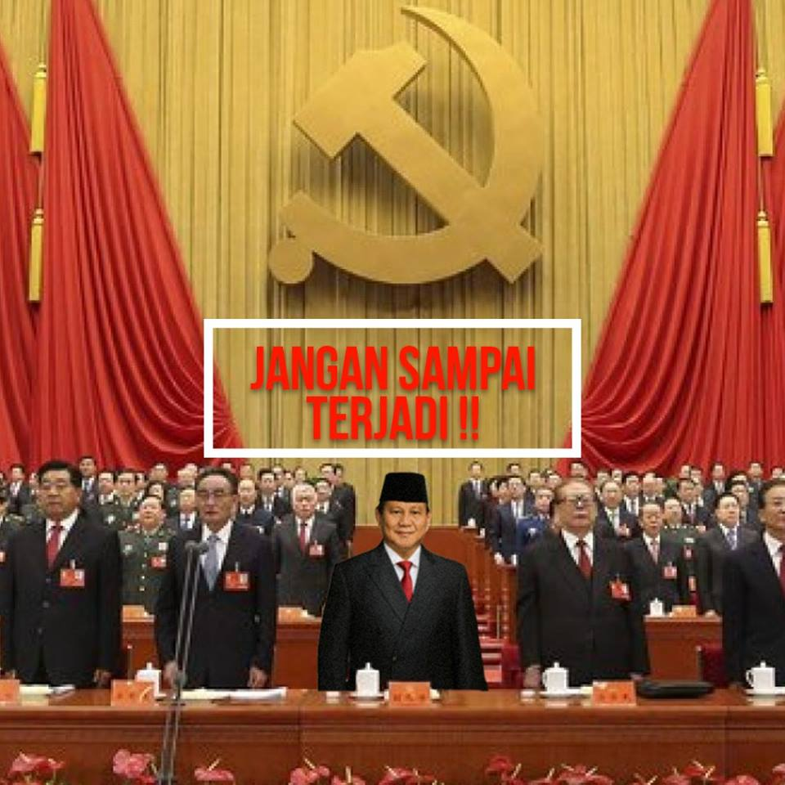
Political Memes and Misinformation
“Don’t let this happen”

Slide 30

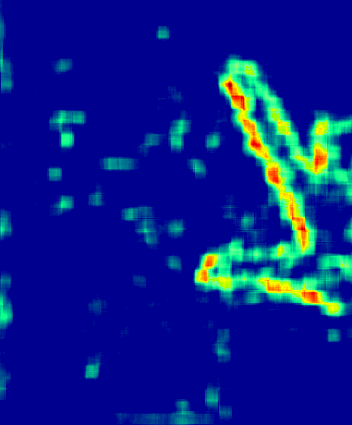
Political Memes and Misinformation
“…he broke his promise not to run again”

Slide 31
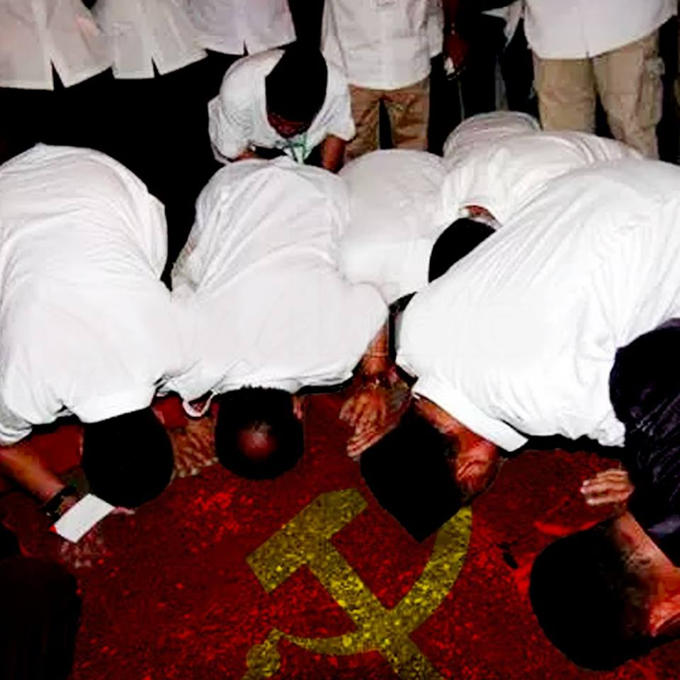
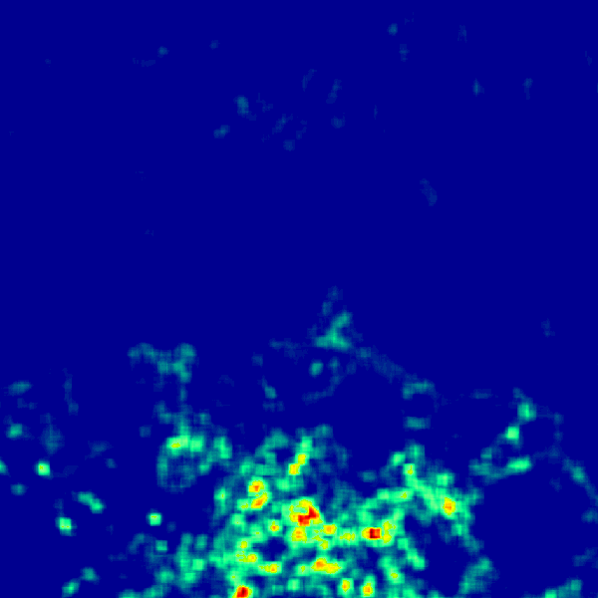
Political Memes and Misinformation

Slide 32
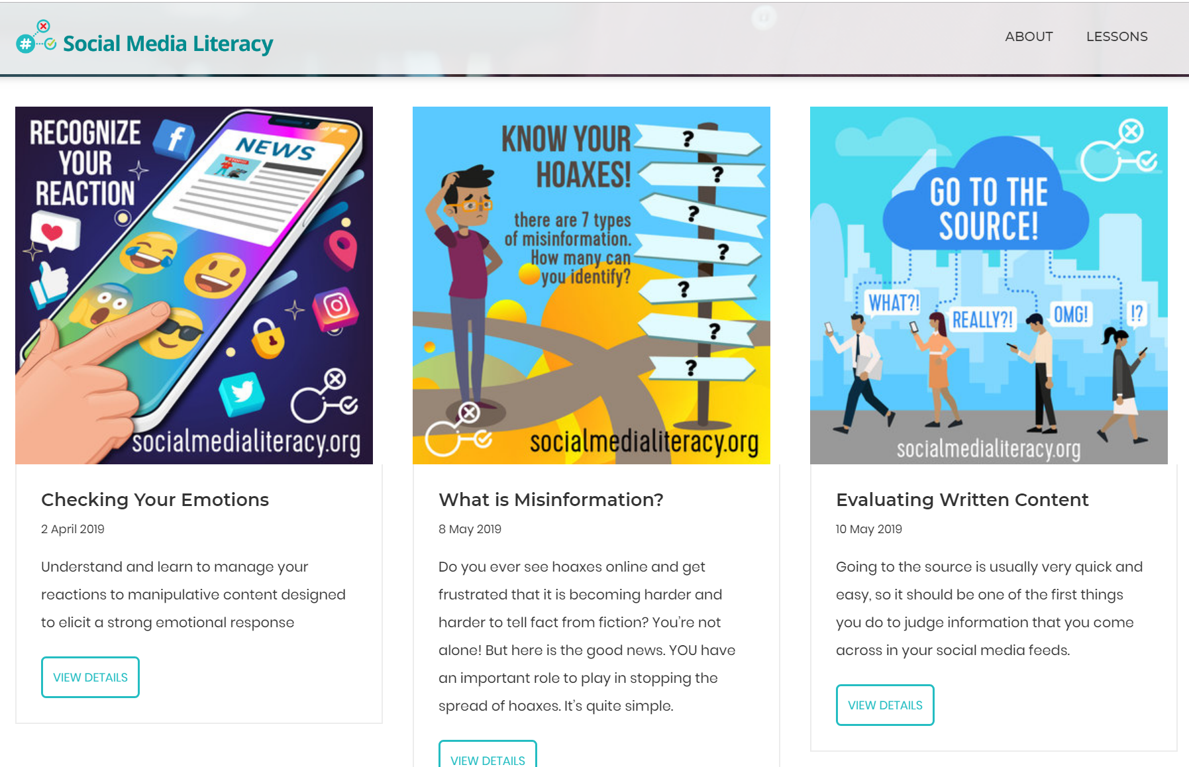
http://socialmedialiteracy.org

Slide 33
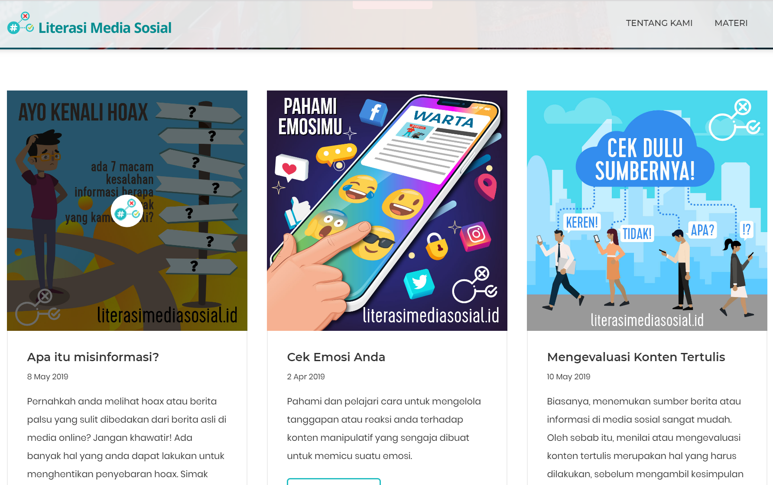
http://literasimediasosial.id

Slide 34


Slide 35
Deploy and Measure
Deploy media literacy campaign via:
  Public messaging campaigns
  Micro-targeting campaigns
  Closed platform targeting
Initial Results:
About 20 million views in December and January.
Results out on Friday.

Slide 36
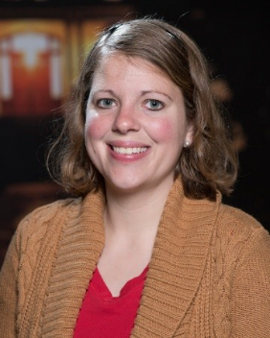

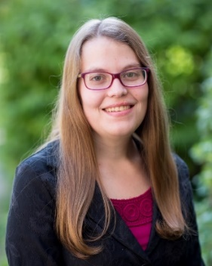
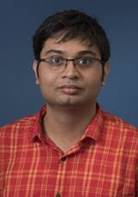
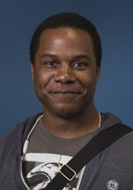
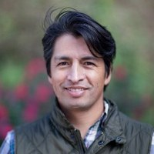
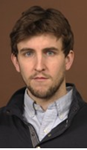
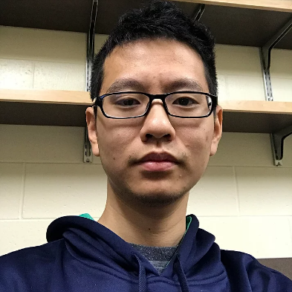
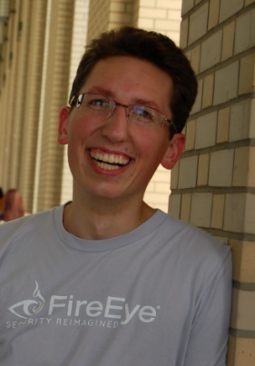

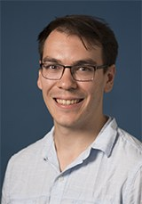
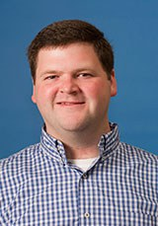
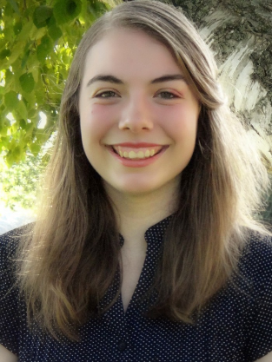






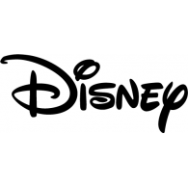

Rockstars:
LinkedIn
Northwestern
University
Cal Poly
University
University of
Notre Dame
Pacific
Northwest
National
Laboratory
Special Thanks To:

Slide 37
Thank you!
(tweninger@nd.edu)

