Slide 1
Clip-event: Connecting text and images with event structures
Li, M., Xu, R., Wang, S., Zhou, L., Lin, X., Zhu, C., … & Chang, S. F. (2022). Clip-event: Connecting text and images with event structures. In Proceedings of the IEEE/CVF Conference on Computer Vision and Pattern Recognition (pp. 16420-16429).

Slide 2
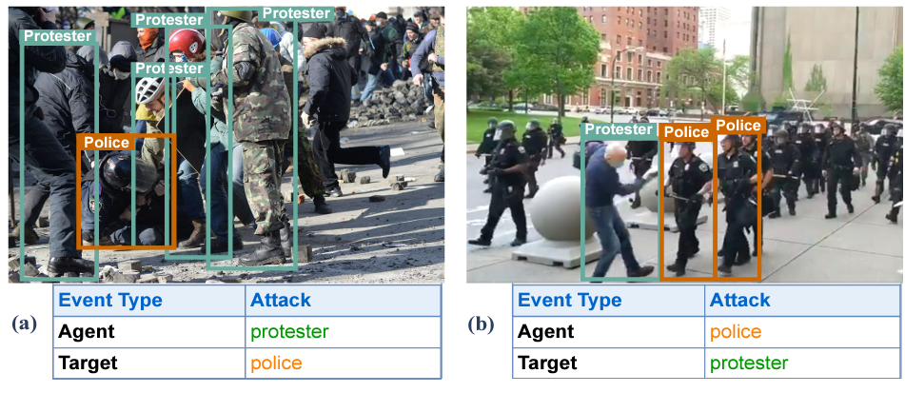
What is the paper about?
“We propose a contrastive learning framework to enforce vision-language pretraining models to comprehend events and associated argument (participant) roles”

Slide 3
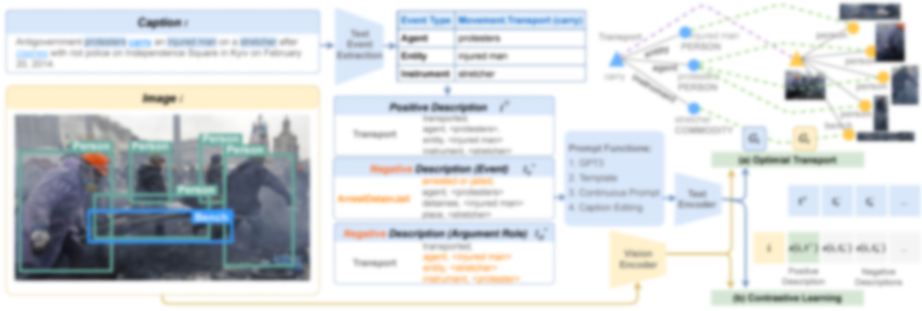
The However Statement
“However, existing vision-language pretraining models focus on the understanding of images or entities, ignoring the event semantics and structures. As a result, apparent failures happen in the circumstances requiring verb comprehension [10]”

Slide 4
The Way of Knowing
Five tasks:
Multimedia Event Extraction
  Zero-shot
  Supervised
Grounded Situation Recognition
Image Retrieval
Visual Commonsense Reasoning
  Answer Prediction
  Rationale Prediction
Visual Commonsense Reasoning in Time

Slide 5
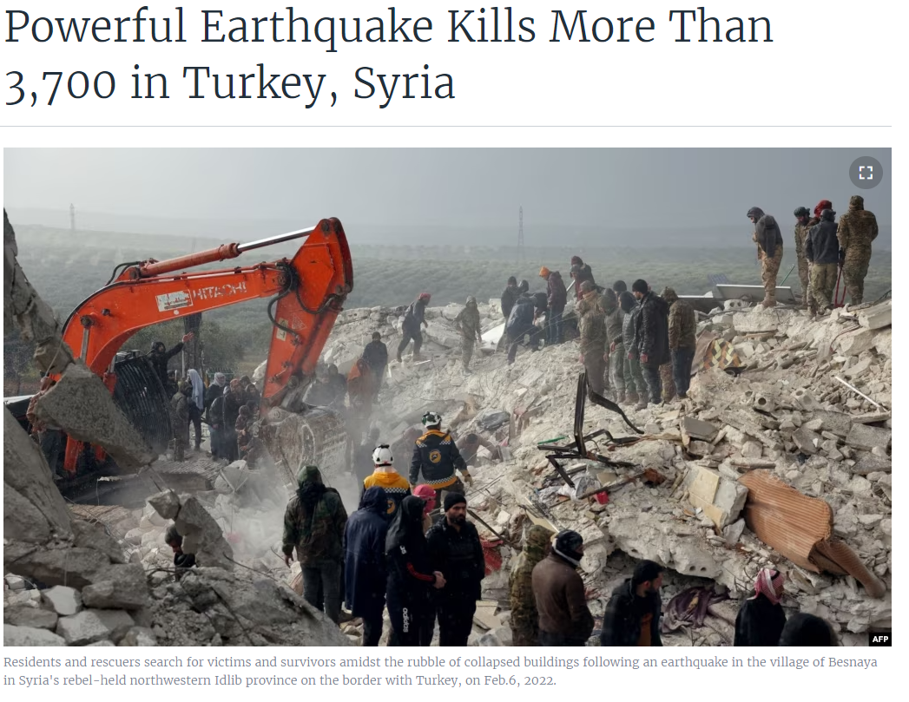
Dataset
106,875 image and caption pairs from a news site

Slide 6
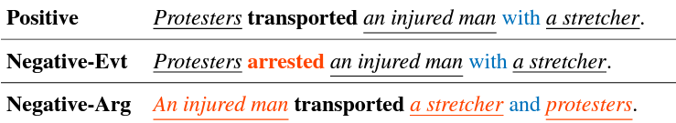
Method of Knowing
Precision
Recall
F1-Score
R@1
Accuracy

Slide 7
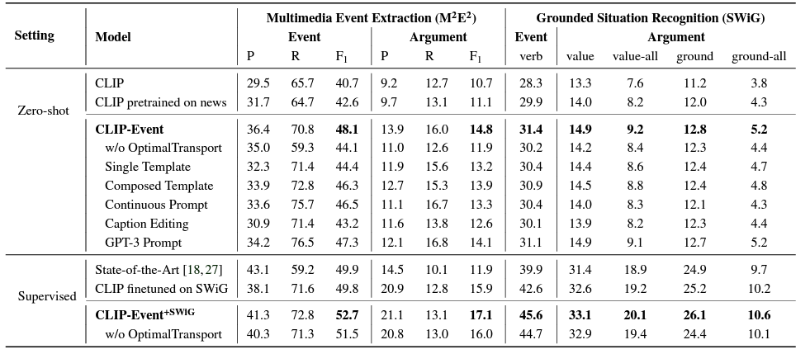
Method of Knowing
Higher Number is Better

Slide 8
Normative Judgement
Pros:
Lots of Results – Experiments on many tasks
Model Appears to work.
Cons:
Experimental evaluation is unclear
No Statistical Analysis
Q: Is there a better way to do negative sampling?

Slide 9
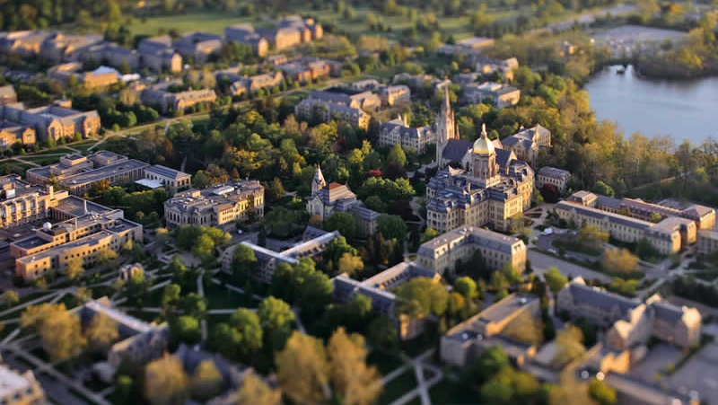
Thank you!
(tweninger@nd.edu)

