Slide 1
Application Oriented Project Building a Database-Driven Web-based Information system
Building a database-driven web-based info. system
Team work: 3-4 people
Goal:
Identify an application domain that:
Requires a database
Accessible over the web
Design the database
Define application functionalities
Implement
Milestone in 4 stages
Due dates on Web site

Slide 2
The most important slide
How to choose a good project topic?
Your application must be useful
Will there be people using your application?
Why should they use your application?
Your application must be realistic
Your data must be real
Where do you get your data?
Amount of data in database must be reasonable
You should have fun
Find an application you like to do and have fun with it

Slide 3
What are some cool projects of the past?
Cavanaugh Mail System
https://www.youtube.com/watch?v=UKZ9U1DCHmo
Weird Algorithm
https://youtu.be/xQwpQ5qXxdU
ICE Cloud
https://www.youtube.com/watch?v=qgPmbFlXlAs
Eds Eatery
https://www.youtube.com/watch?v=NOPa8qgm-yI
Pokedex 2.0
http://www.youtube.com/watch?v=YTYQuESBvbU
Remember that your application can be the next startup

Slide 4
Some other interesting project ideas?
Academic:
Course material search, project partner search , …
Entertainment:
Book recommendation, music/playlist sharing, fantasy football analysis, ….
Productivity systems:
Task management, human resource management, …
Healthcare:
Physician recommendation

Slide 5
Some other interesting project ideas?
Social Media:
DevianArt/Facebook mashup , …
Others:
Stocks, weather tracking, ….
What is your crazy idea?

Slide 6
Fall 2022 projects
StudyBuddy
Volo (I Fly)
HesHelpers
Weird Algorithm
SQL Squad
Spanky’s
UBalance
Audio Odyssey
BetsButStocks
IMND
DatabaseD

Slide 7
Fall 2022 projects
BoutsMart
MUSaIC
Grillemasters
NDEats
Beverage Buddy
Cultivate
ZeeFood
ScreenKings
La Musica
bacND
TravelFrieND
SNATA

Slide 8
Fall 2021 projects
Whish List
Rational (Food Cart)
Multimember DJ
Grocerize
GameOn (Intramural Sports)
Music++
ScareBnB
PawPatrol
BarteNDr
BetterSports
ND Football Analytics

Slide 9
Fall 2021 projects
TreNDy
Pollution Detector
Social Media Political Aggregator
Microbe Enrichment DB
F00dies
PathToTheParks
CaffControl
DanceDateFinder
SiggyZa (Siegfried Piazza Ordering)
DonationDiscovery
StoryLine

Slide 10
Fall 2020 projects
Bringin the Band Together
On Demand Tutoring Service
Flex Points Management System
Workout Planner
Study Abroad Recommendations
Emergency Health Records
Bullying Incident System
Product Barcode Financial Information
MMA Analytics
Autism Law Resources Database
Trips Abroad

Slide 11
Fall 2020 projects
Reddit Post Predictor
Notre Dame Student Club App for First Years
Movie Trailor Mashup Selector
Holy Cross Recruitment App
ND Varsity Football Analytics
Dorm Selector
Love Finder
Finance in Your Pants
Knott Food Court
Meme Finder
Nice Mice (Mouse Breeding)
ISSLP Student Outcomes

Slide 12
Our expectation for projects: STAGES
Every stage must be approved to get a passing grade
Stage 0: Group formation
Stage 1: Functional Desc / ER design
Stage 2: Development Plan/Development environment
Stage 3: Initial Demo
Stage 4: Final Demo and Report – Dec 14ish, 2022

Slide 13
Our expectation for projects: GRADING
Stage 1: Functional Description and ER design – 5%
Stage 2: Setup Development Environment – 1%
Stage 3: Initial Demo – 15%
Data:: Have real data
Insertion:: Be able to insert record to DB
Update:: Be able to update record in the DB
Deletion:: Be able to delete record from DB
Search:: Be able to query DB and print the result
Plan:: Detailed plan for the rest of the project

Slide 14
Our expectation for projects: GRADING
Stage 4: (80%)
Final Demo => 65%
Everything should be working
Final Report => 5%
Review on the details of the implementation process
Review on Challenges
Any deviation from plan and the reason
Demo => 10%
2 minute Youtube video
You need to have a complete working system to get passing grade

Slide 15
Some other cool projects in the past?
Vantage
https://www.youtube.com/watch?v=7ZqnYG6A0xU
Inventory Bank
http://www.youtube.com/watch?v=favGw3w4nH8
Remember: This is your chance to work on your dream

Slide 16
Project requirements:
4 Basic functions:
Insert records to the database
Search the database and print returned results
Must demo several interesting queries
At least one query must involve join of multiple tables
Must have real data in the system
Show how to update records
Show how to delete records

Slide 17
Data requirements
Get data from some source
Do not attempt to gather data on your own
http://data.almosteverything.gov
http://data.gov
https://hub.mph.in.gov
https://data.nd.edu
Kaggle
https://datasetsearch.research.google.com/

Slide 18
Project requirements
2 advanced functions:
Should be relevant and useful for your application
Don’t exist in equivalent web sites/applications
Go beyond the basic functions
Should be technically challenging
Need to spend some significant time (at least 2-3 days of work for the whole team per advanced function) to implement
You should be able to define the technically challenging problem and your solution

Slide 19
Advanced Functions
2 advanced functions:
Using 3rd party API (e.g. Google Map API,…) will get you no points unless you do some challenging stuff on preparing/analyzing the require data
You need real data in the system. You can get that from any resource but there should be an easy automatic way to insert data whenever needed.
If you rely on users to enter data into your system, you must have your project up and running at least 1 week before your demo.
You can ask your friends, TAs, student of class to use your system but you are responsible to get real data into your system

Slide 20
Advanced Functions
Examples:
Creative use of Google Maps
Pokedex: Overlay pokemon world onto Google Map
Google Map itself receives 0 points
Cellphone App for iOS/Android can get you good grade
Not:
User-friendly interface
“I code the site with ajax”

Slide 21
Google Maps does not count

Slide 22
Google Maps does not count
Seriously…
You can use Google Maps if you want, but it will not count towards the advanced functions requirement.

Slide 23
Client
Access the web app
Example: IE, Firefox, iPhone, Chrome, Android
Presentation
Renders information, generates webpages
Example: HTML, DHTML, XML, Javascript
Manage data access, performs calculations, makes logical decisions
Example: ASP, PHP, Perl
Logic
Database
Stores and manages data
Example: MySQL, Oracle

Slide 24
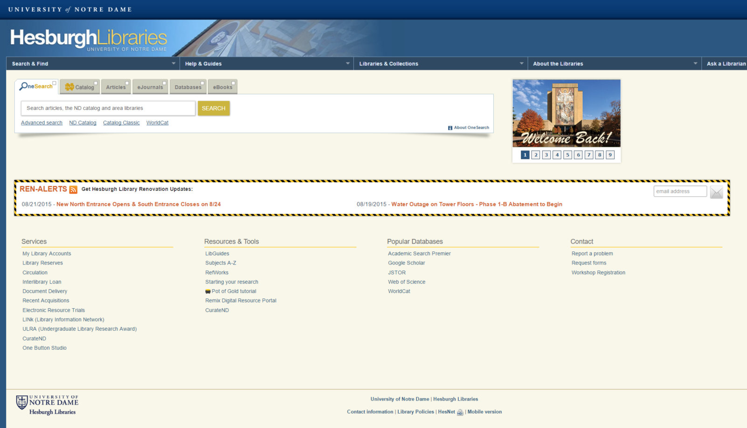
Client
Application is a website accessible via a web browser:
Presentation
Logic
Database

Slide 25
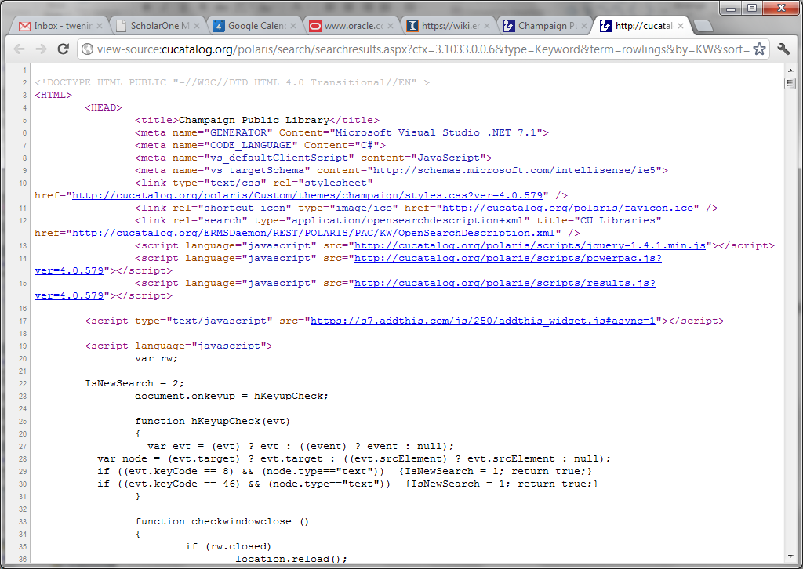
Client
Presentation
Use HTML and Javascript to create Web site
Logic
Database

Slide 26
Client
Presentation
Logic
PHP, et al., takes a string input and makes a SQL query
Database

Slide 27
Client
Presentation
Logic
Database
Mysql processes the query and returns results

Slide 28
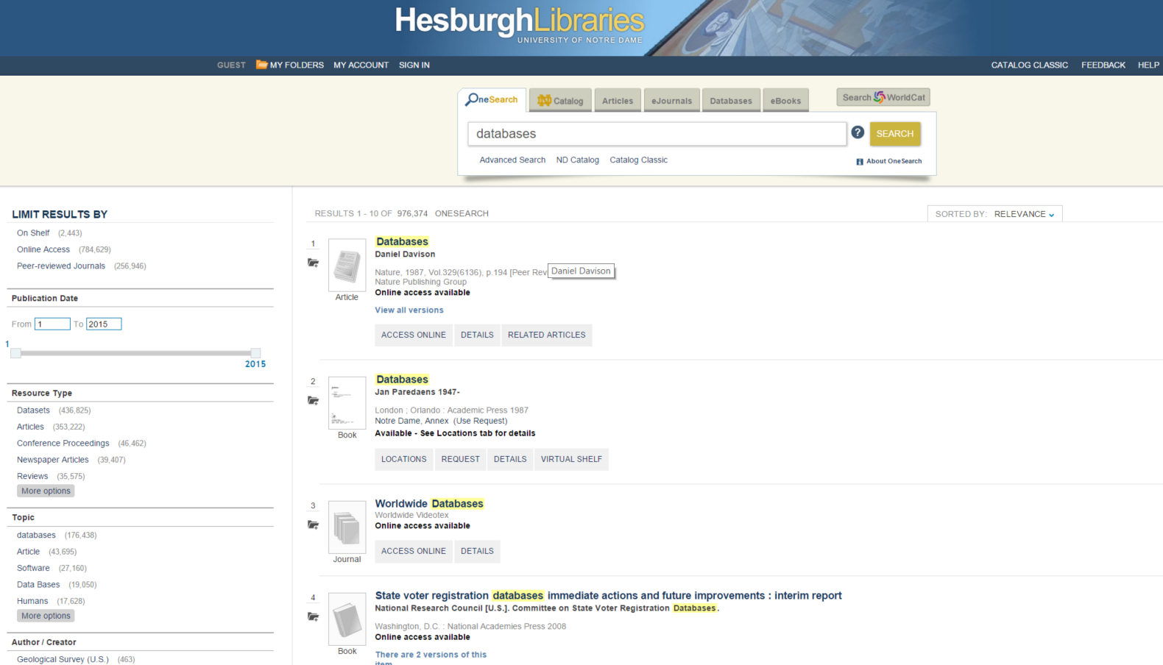
Client
Presentation
Logic
PHP, et al., processes the results, i.e., turns database objects into book records
Database

Slide 29
Client
Presentation
HTML and Javascript render the results
Logic
Database

Slide 30
Client
Client displays the results
Presentation
Logic
Database

Slide 31
Client
Client
Presentation
Internet
Server
Logic
Database

Slide 32
How to implement a Web application
Client
Client
Presentation
HTML, JavaScript, CSS
Logic
Database

Slide 33
How to implement a Web application
Client
Presentation
Server
Logic
PHP, ASP, Python, Java
Database

Slide 34
How to implement a Web application
Client
Presentation
LAMP – Linux, Apache, MySQL, PHP
Server
Logic
Web Server
Database
DB Server

Slide 35
Common tools for building web apps
Framework:
LAMP
Client side:
Examples: CSS, Flash, HTML, DHTML, Javascipt
Server side:
Examples: ASP, Java, Perl, PHP, Python, Ruby
Web server:
Examples: Apache, Tomcat
Database:
Examples: MySQL, Oracle, Postgres

Slide 36
We will help you with project tutorials
Client
Client
Presentation
Web Programming
Logic
Server
DB Programming
Database

Slide 37
Project tips
Read Projects page on the Webpage to get started
I have provided development environment
Database: MySQL
Web server: Apache
Start early
Unexpected issues
Form groups now
Have a questions? Problem forming group?
Post to Canvas

