Slide 1

Popularity vs Quality
Effects of Path Dependency in the Attention Economy
Tim Weninger
(with Maria Glenski, Greg Stoddard, Paul Resnick)

Slide 2
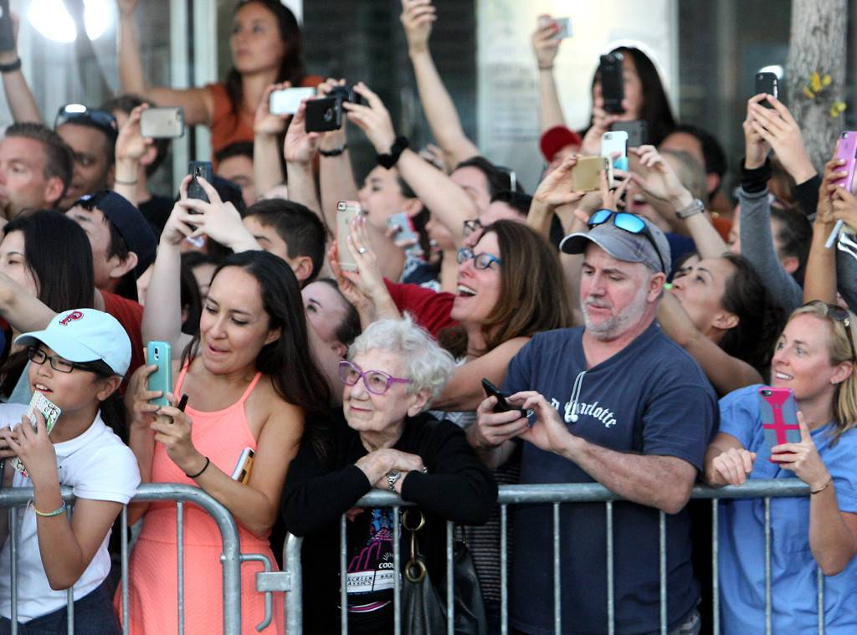
What is the relationship between quality and popularity in online social media?

Slide 3
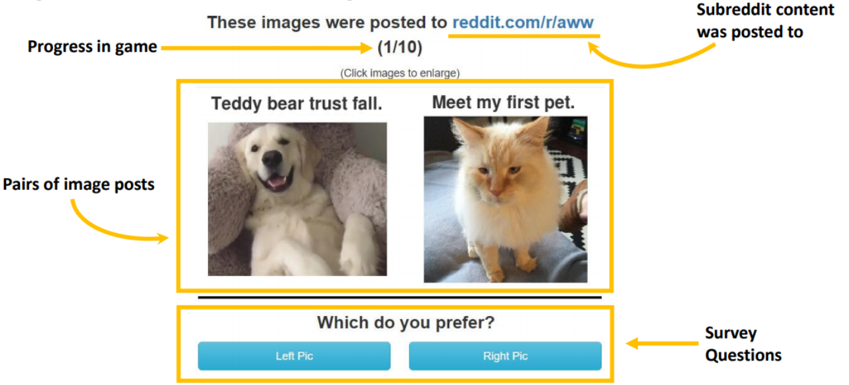
GuessTheKarma – a social rating experiment

Slide 4
How well did people do?
Random guess: 50% accuracy
Results: 58% accuracy (preference)

Slide 5
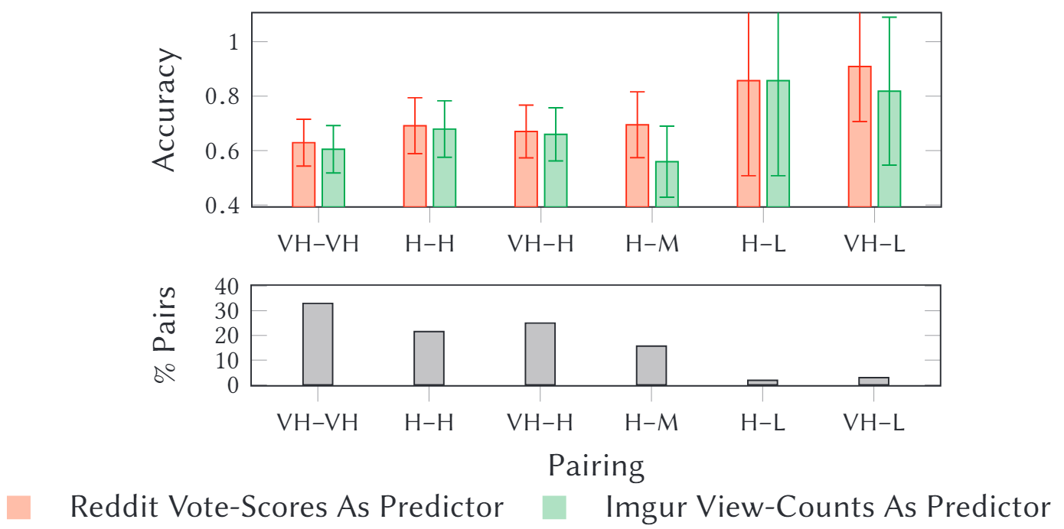
[Flip the problem] How well did social media do?
Use Reddit-scores / Imgur-views to predict what humans actually prefer

Slide 6
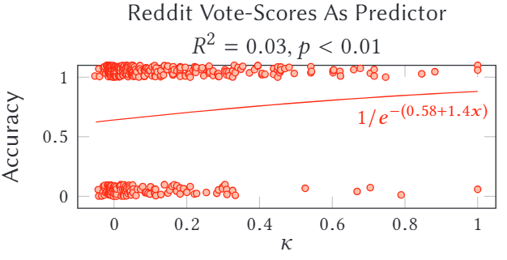
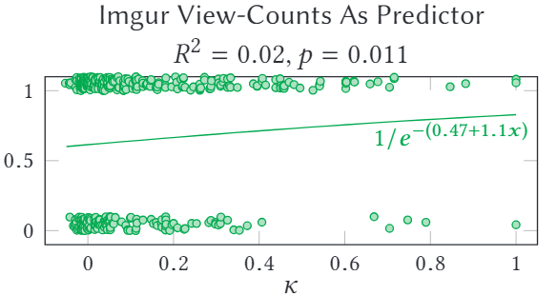
[Flip the problem] How well did social media do?
Accuracy vs agreement

Slide 7
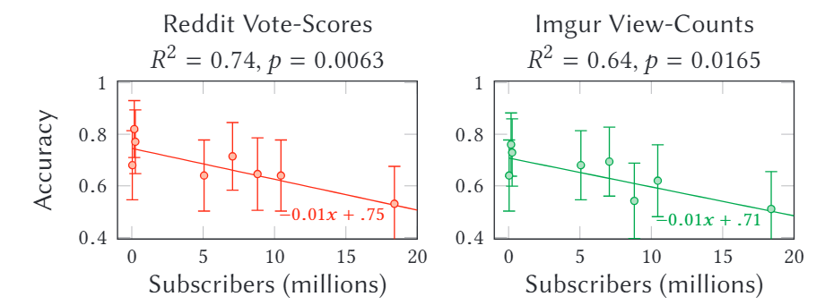
[Flip the problem] How well did social media do?
Accuracy vs subreddit size

Slide 8
Reddit experts – are they better guessers?
We asked how much each GTK player used Reddit:
  63 people answered yes to all questions (superusers)
  122 answered no to all questions (non-users)
  Superusers were no more accurate than non-users
What does this mean?
Only a small relationship between a post’s “goodness”¹ and its eventual “popularity”
¹According to a proper (path-independent) survey of users

Slide 9

Thank you!

