Slide 1

Humans, Interaction, and “The Algorithm”
Tim Weninger
Associate Professor
Computer Science and Engineering

Slide 2
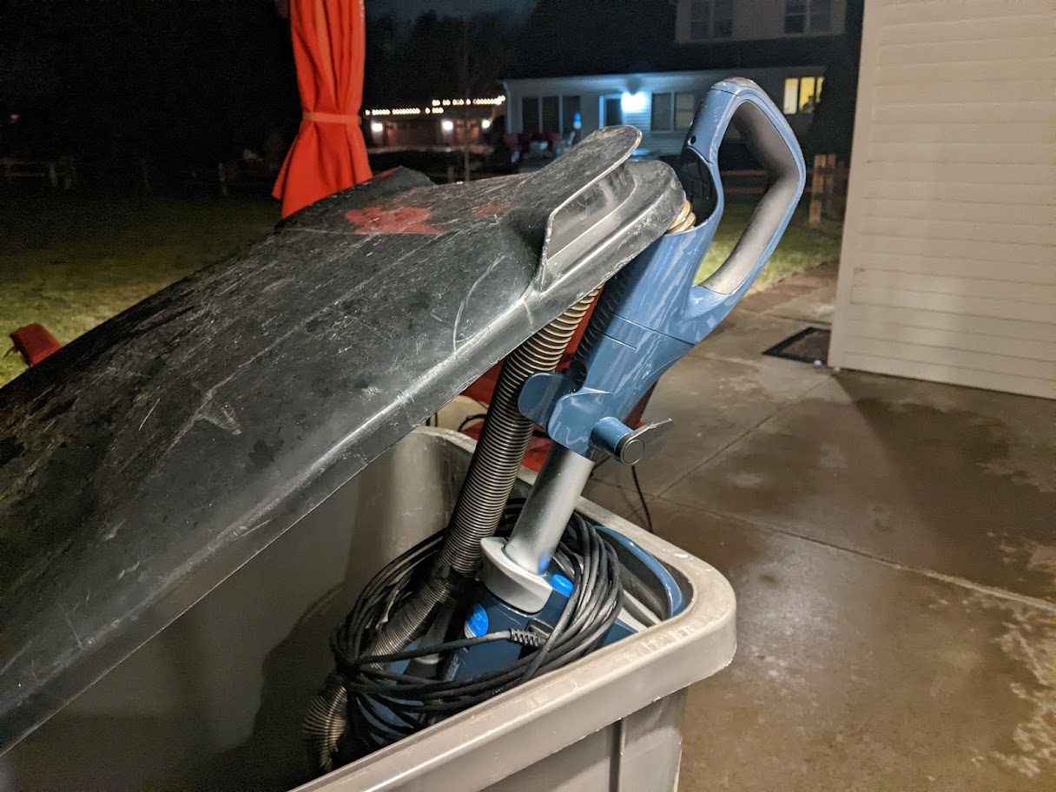

Artificial Intelligence and Social Media

Slide 3
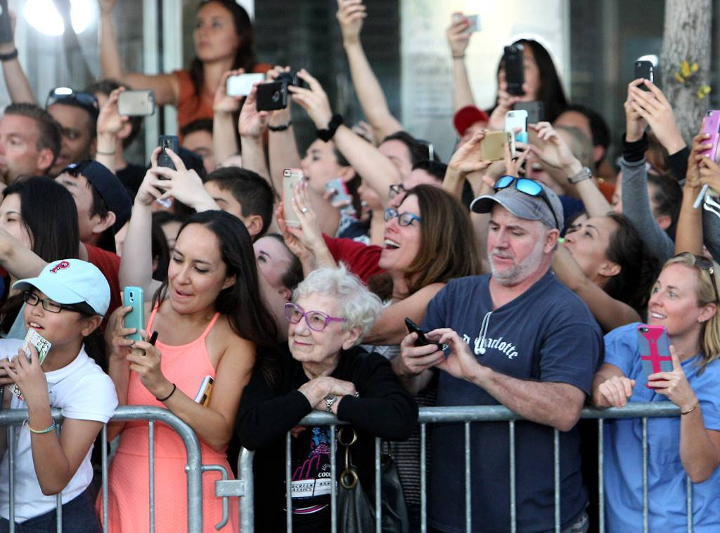
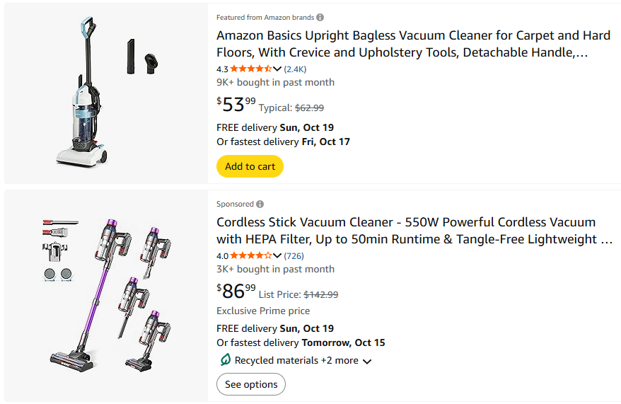
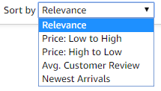
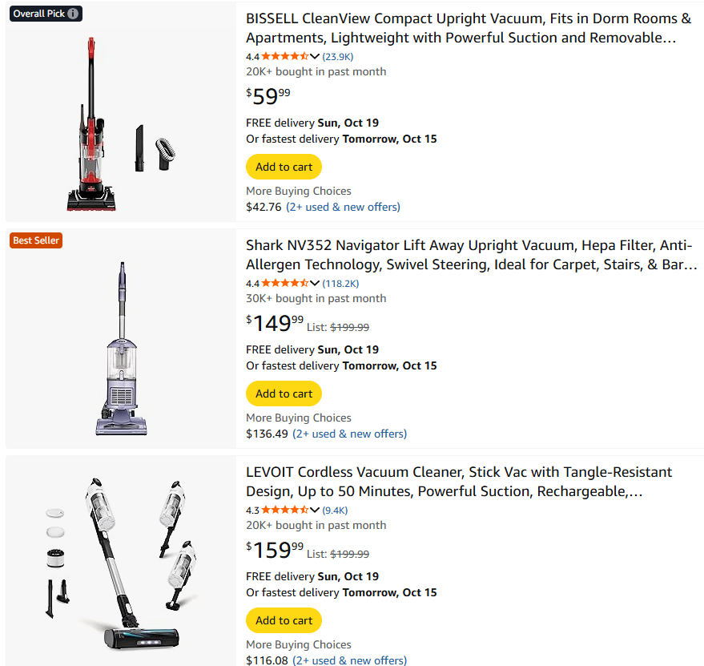
Humans and AI: The Dance

Slide 4



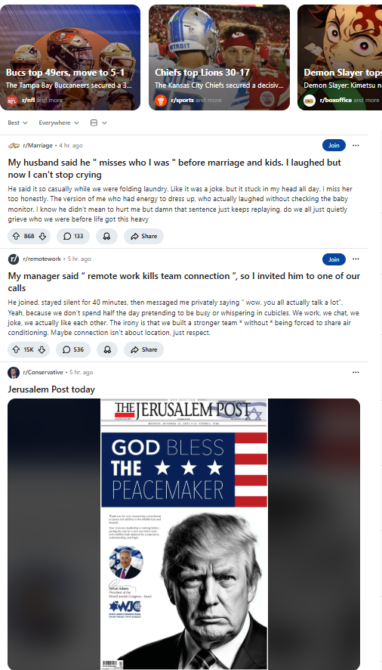
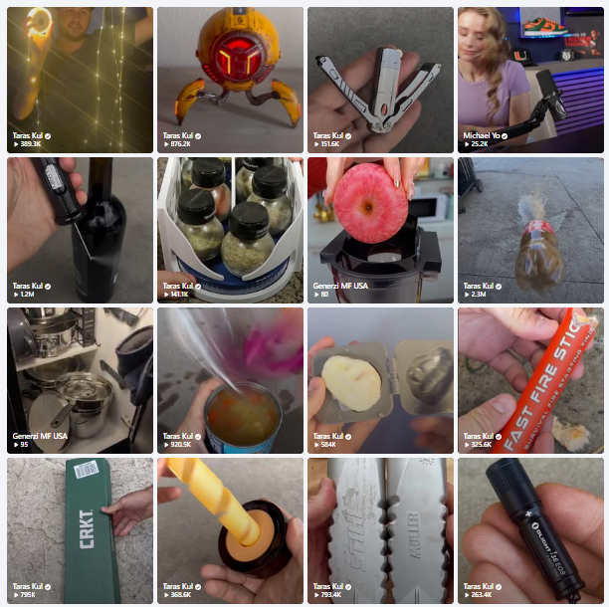
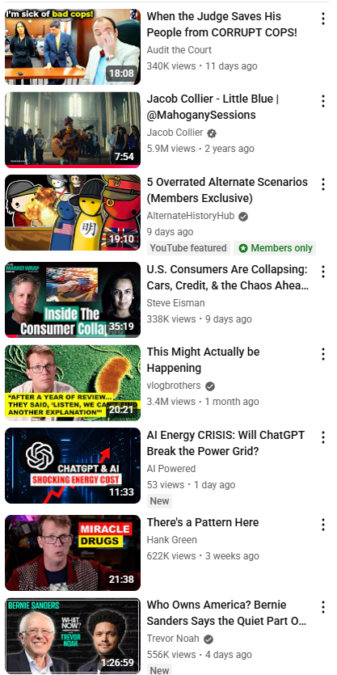
Humans and AI: The Dance

Slide 5
Manipulation of Social News
Manipulation of Social News
Weninger Oct 21, 2013

Slide 6
Social News:
On the Creation and Spread of Information

Slide 7
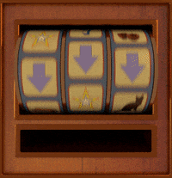
Vote Injection
Randomized in-vivo social voting experiment:
Upvote, downvote, or nothing-vote newest Reddit post
Every 2 minutes
For 4 months
Resulting in 93,000 total vote injections

Slide 8
Vote Injection – a single vote
Posts
Comments

Slide 9
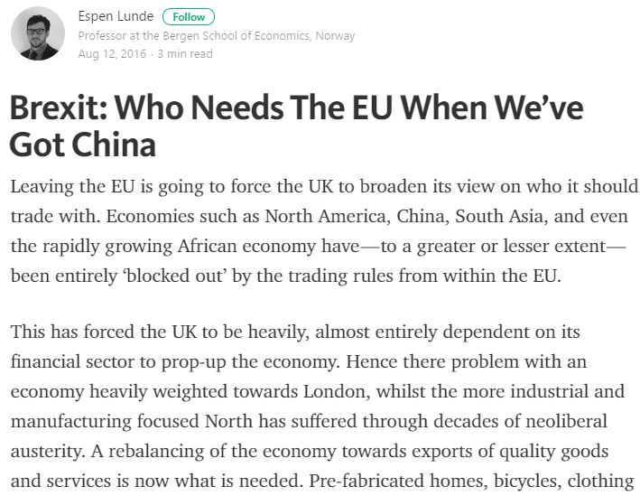

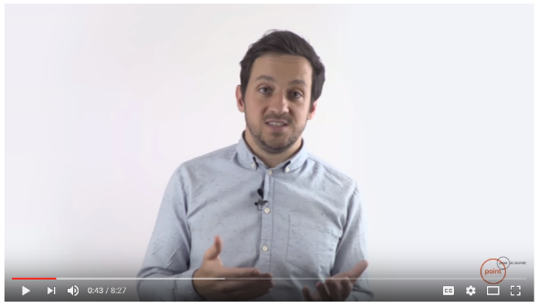
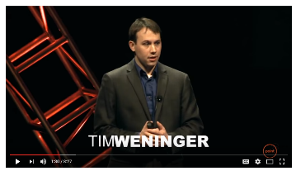
How easy is it?

Slide 10
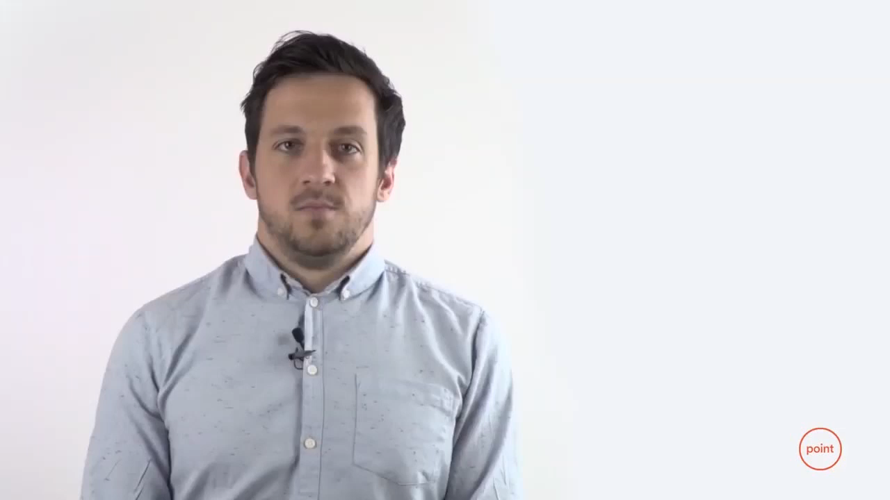

Slide 11
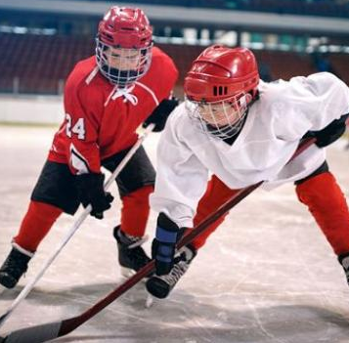
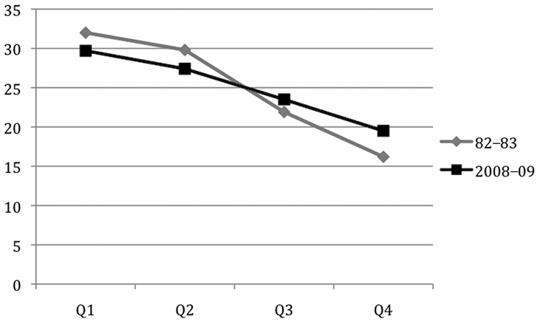
Allow me to explain
Number of Hockey Players
Birth Month
Principle of Accumulated Advantage

Slide 12

Allow me to explain
Visibility Bias – rich-get-richer, Matthew effect

Slide 13
Popularity vs Preference
Are social voting systems broken?
Does social media show us the posts we want to see?

Slide 14
GuessTheKarma – a social rating experiment

Slide 15
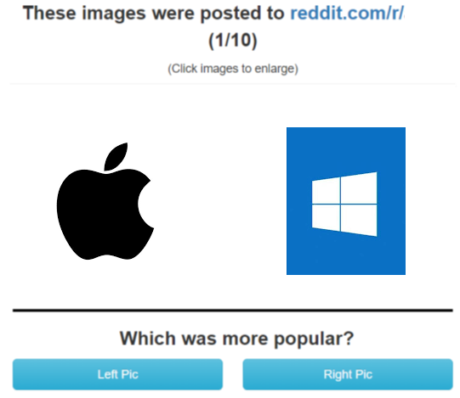
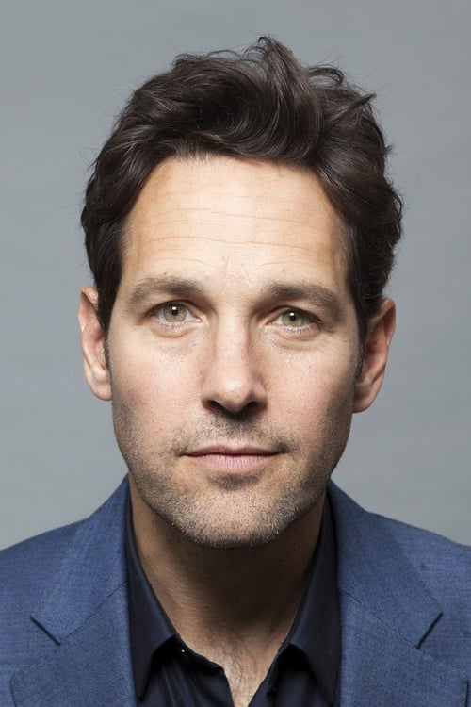
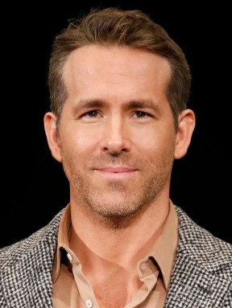
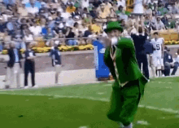
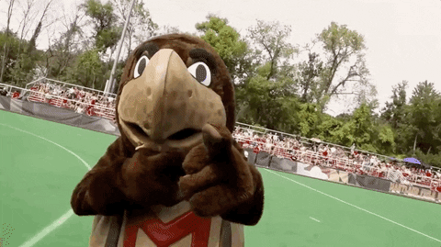
GuessTheKarma – a social rating experiment

Slide 16
How well did people do?
Random guessing: 50% accuracy
Results: 52% accuracy

Slide 17
Powerusers – are they better guessers?
We asked how much each user used Reddit/Imgur/Twitter:
  Heavy users were no more accurate than non-users
What does this mean?
(Almost) No relationship between a what people want to see
and what they actually see on social media

Slide 18

So what now?
http://tokornot.com
Basically, the same results
Understand why these problems persist on social media.

Slide 19
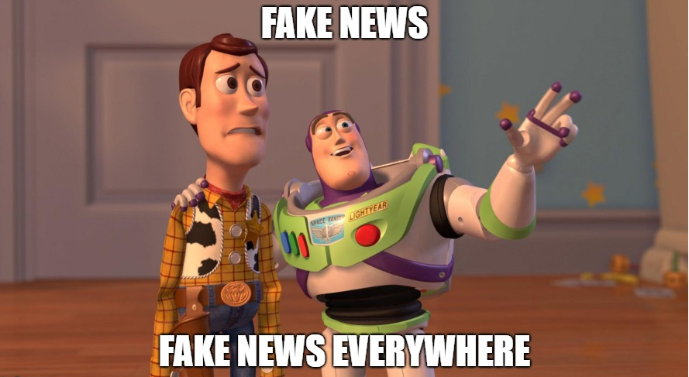
Spread of misinformation:
Its all our fault

Slide 20
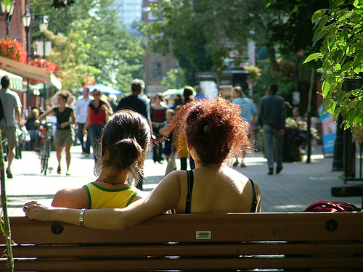
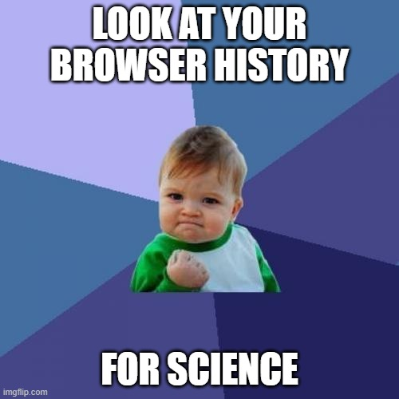
People Watching

Slide 21
Most People Don’t Vote
Headline Browsers:
Most people don’t click on anything
Most people don’t vote

Slide 22
Most People Read before they Vote
Most people don’t read before they vote, like, or share
74% of votes occurred without the user ever viewing the post.

Slide 23
Most People Don’t Read Most Things
Visibility bias is huge
7% of clicks went to top post,
<0.1% went to #25

Slide 24
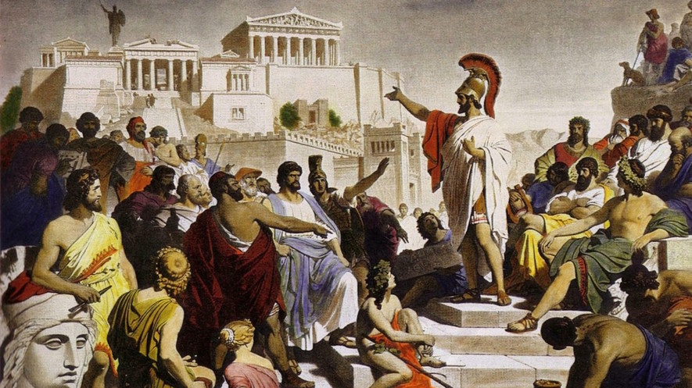
What about Artificial Intelligence?

Slide 25
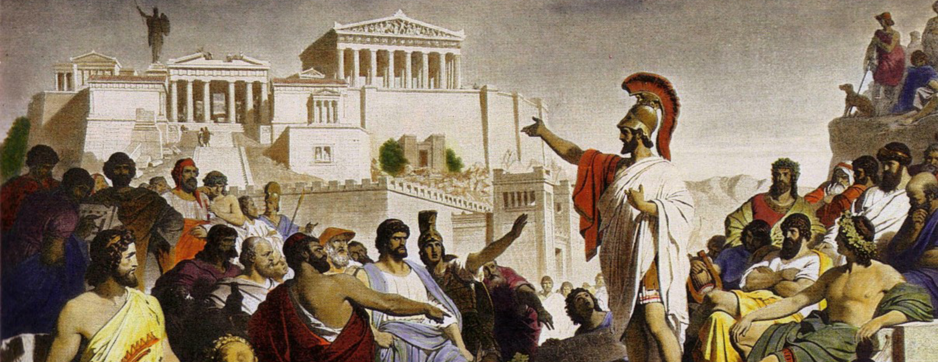
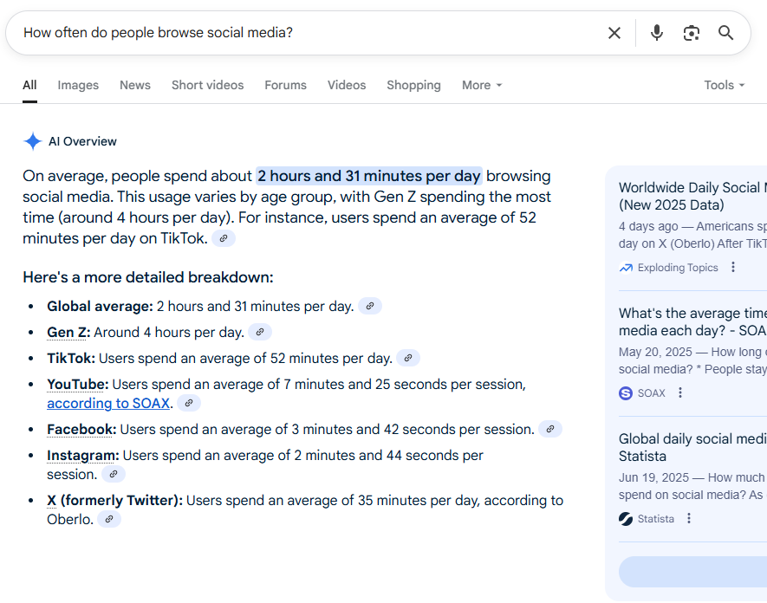
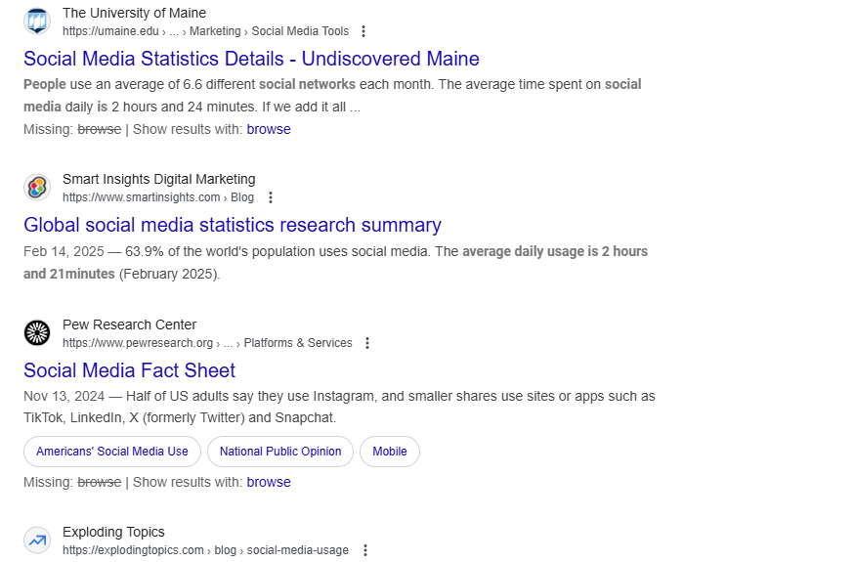
Research Question
The Web is Changing

Slide 26
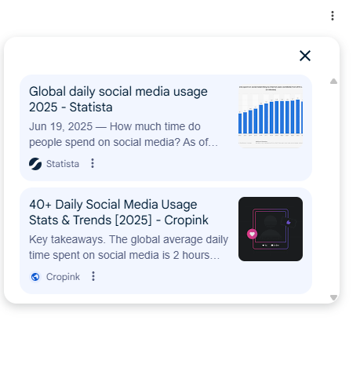

Research Question
The Web is Changing

Slide 27
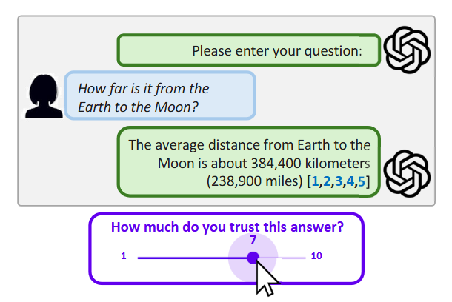
Do Citations Increase Trust in AI-Answers?

Slide 28









Citation Experiment?
Valid Citation(s)
Random Assignment
The average distance from Earth to the Moon is about 384,400 kilometers.
[1,2,3,4,5]
One Citation
Valid Citation(s)
Random Citation(s)
No Citations
Five Citations
The average distance from Earth to the Moon is about 384,400 kilometers.
Random Assignment
[1]
Trust Survey
The average distance from Earth to the Moon is about 384,400 kilometers.
How much do you trust this answer?
Please enter your question:
[1,2,3,4,5]
1
7
10
How far is it from the Earth to the Moon?
Random Citation(s)
The average distance from Earth to the Moon is about 384,400 kilometers.
[1]
Repeat for
10 questions
The average distance from Earth to the Moon is about 384,400 kilometers.
Participants
Methodology
Response
Demographics Survey

Slide 29
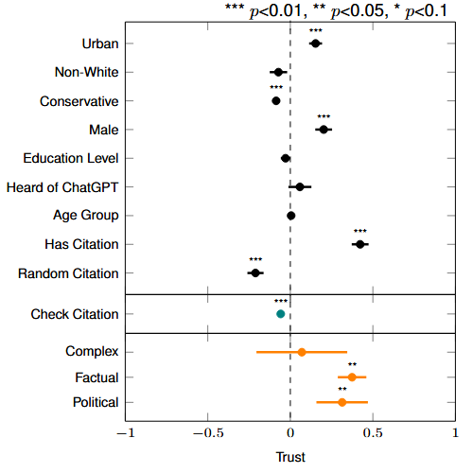
Citations improve trust
Checking citation is negatively associated with trust.
People trust factual and political answers

Slide 30

Case Study:
Україна проти Росії

Slide 31
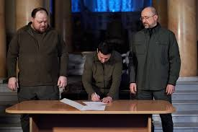
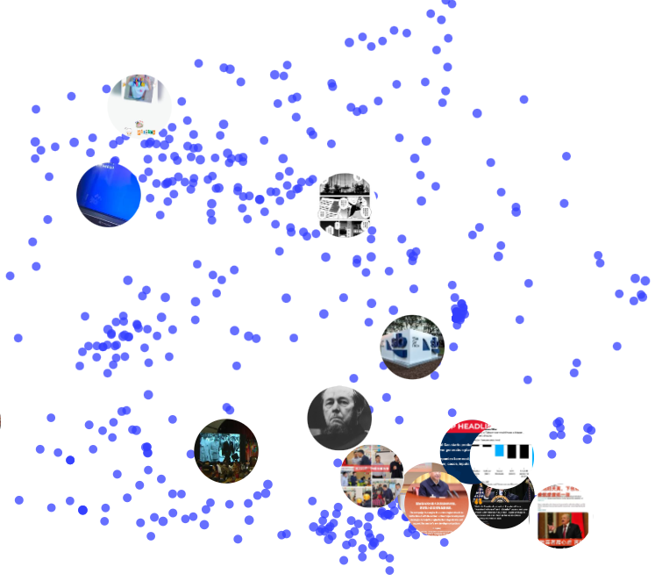

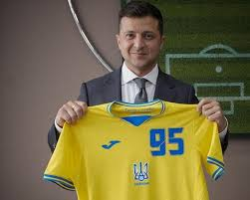
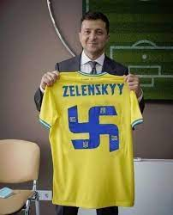
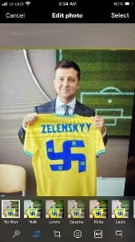
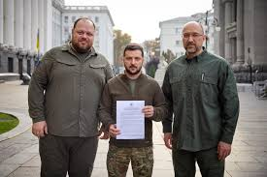
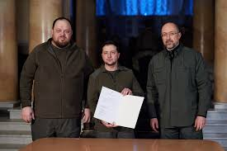
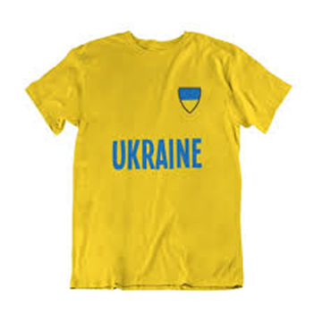
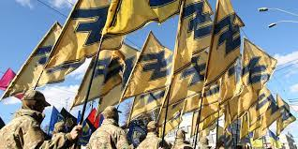
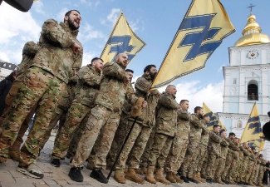

Politically Salient Image Patterns
Pattern of Zelensky signing an agreement
Replicated and Shared Pattern of Zelensky holding a jersey
Pattern of Azov Brigade and Nazi Symbolism
Figure contains many deceptively altered images

Slide 32

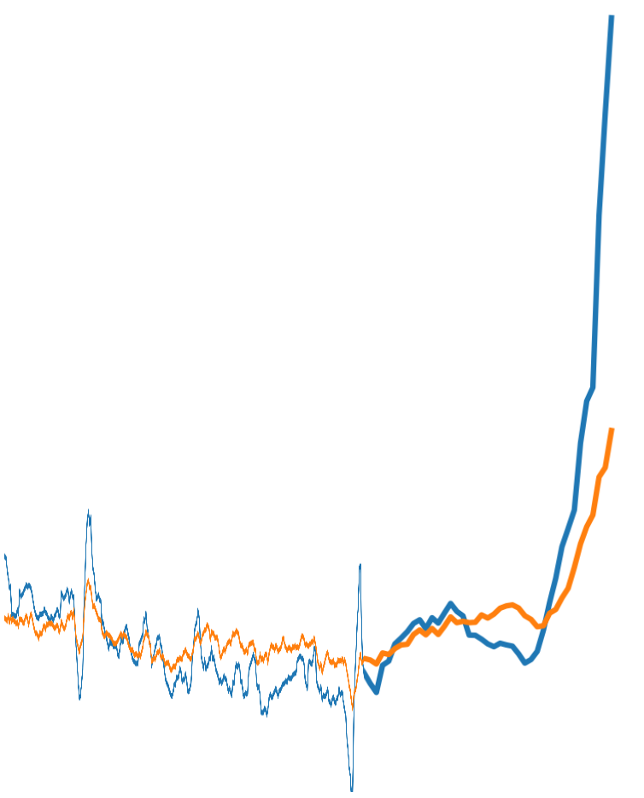







Socio-Digital Conditions leading to the Russia-Ukraine War
“Special Operation” Begins
…
Two Weeks Prior to Full Invasion
Russian Milbloggers
Typical Rate of Posts
+8000% increase in the numbers of posts by Russian-accounts in the two weeks before the election.
time

Slide 33
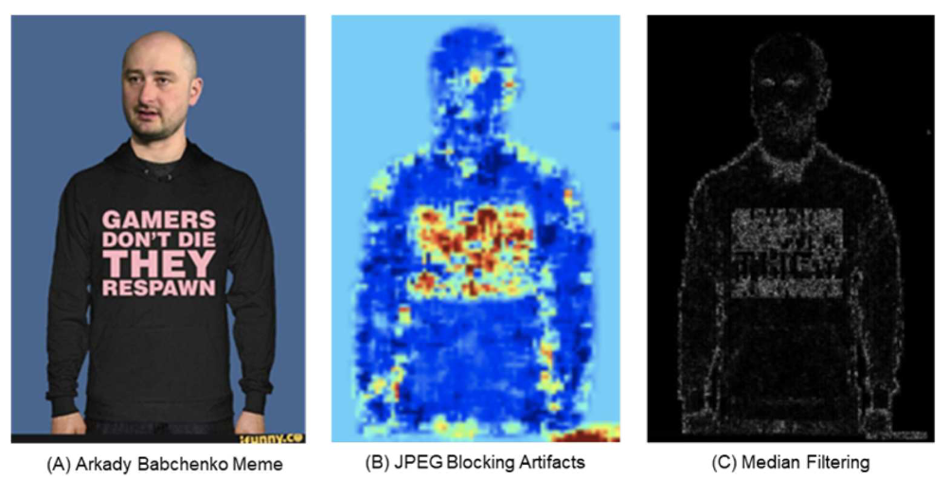
Media Manipulation Detection

Slide 34
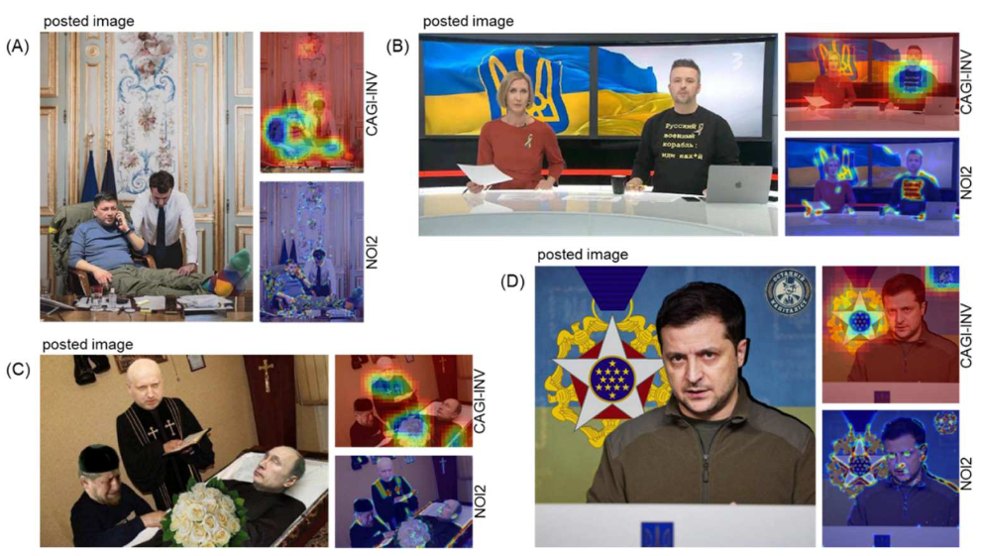
What kinds of manipulation?

Slide 35
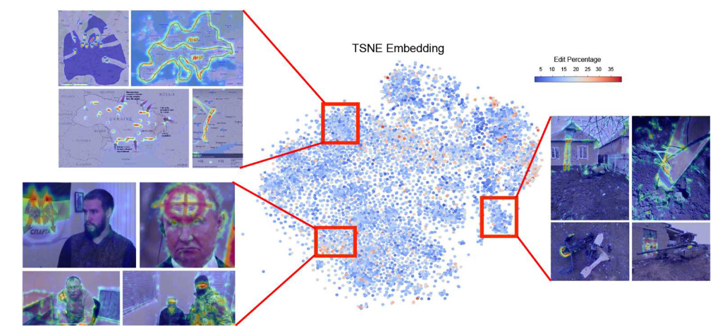
What kinds of manipulation?

Slide 36
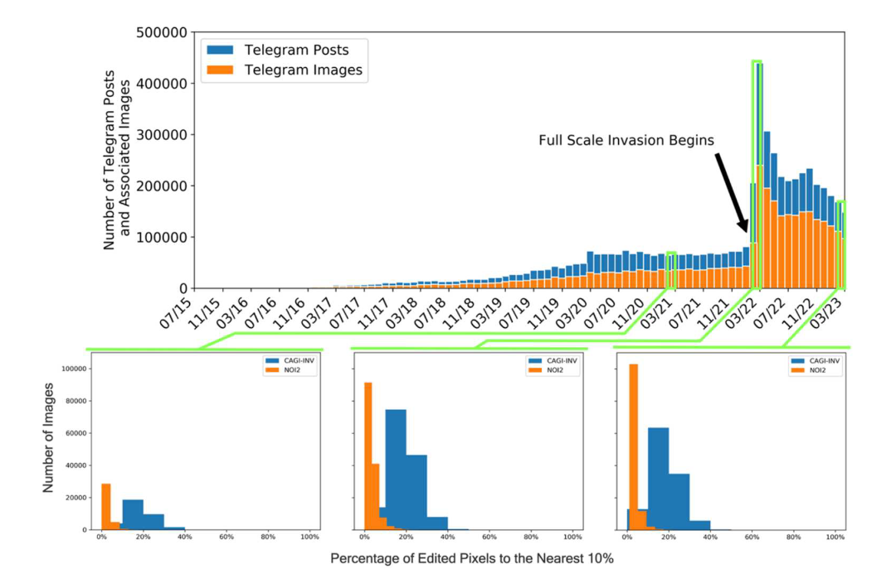
How much?
+5000% increase in the numbers of manipulated images posted by Russian-accounts in the two weeks before the election.

Slide 37
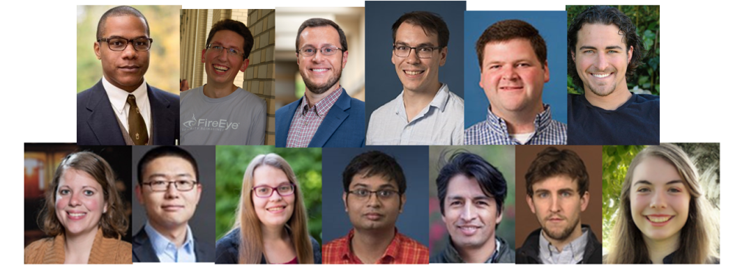
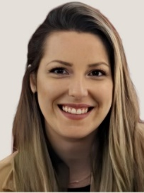
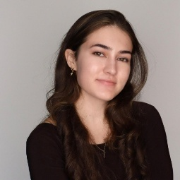
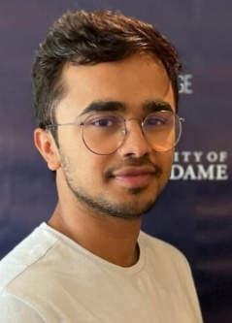
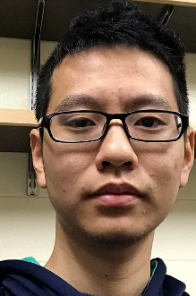
















The Team
Rockstars
Alumni
Special Thanks To:

Slide 38





Slide 39


Slide 40

Thank you!
(tweninger@nd.edu)

