Slide 1
A Database-Driven Web-based Information system
Building a database-driven web-based info. system
  Team work: 3-4 people
Goal:
  Identify an application domain that:
    Requires a database
    Accessible over the web
  Design the database
  Define application functionalities
  Implement
Milestone in 4 stages
  Due dates on Web site

Slide 2
The most important slide
How to choose a good project topic?
  Your application must be useful
    Will there be people using your application?
    Why should they use your application?
  Your application must be realistic
    Your data must be real
      Where do you get your data?
    Amount of data in database must be reasonable
  You should have fun
  Find an application you like to do and have fun with it

Slide 3
What are some cool projects of the past?
Cavanaugh Mail System
  https://www.youtube.com/watch?v=UKZ9U1DCHmo
GoGolf
  https://www.youtube.com/watch?v=jufT189dtRw
Remember that your application can be the next startup

Slide 4
Some other interesting project ideas?
Academic:
  Course material search, project partner search , …
Entertainment:
  Book recommendation, music/playlist sharing, fantasy football analysis, ….
Productivity systems:
  Task management, human resource management, …
Healthcare:
  Physician recommendation

Slide 5
Some other interesting project ideas?
Social Media:
  DevianArt/Facebook mashup , …
Others:
  Stocks, weather tracking, ….
What is your crazy idea?

Slide 6
Fall 2025 projects
ballstreet
Bubble
cookout
footysocial
gogolf https://www.youtube.com/watch?v=jufT189dtRw
opencif
preesh
suitechild
Brand https://drive.google.com/file/d/1OJrJyDZ2y59ckljkwRuEjMYHBhWK8HxS/view

Slide 7
Fall 2025 projects
Caffiend: https://drive.google.com/file/d/1l_CXdDFX3DOOCnOH9WA3I462e1t7REN4/view
flightbowl
fourthngold
irishconnect
pantryscheduler
stushop
Tweeds https://drive.google.com/file/d/1SWwy7mtPCvpyXfvWrfmGDsGpjEuBcuv8/view

Slide 8
Fall 2024 projects
Boss
NDSmashStats
CourseCrafter
OWD
PapasSteezeria
CulinaryChronicles
PantryPal
Plnd4u
CulinaryCanvas

Slide 9
Fall 2024 projects
BuildingBytes
BeatBook
NDGradGate
EcoTrip
StoneSoup
MastermiNDs
NDFood
WeatherWizard
EddyEats
JetStream

Slide 10
Fall 2024 projects
Boss
NDSmashStats
CourseCrafter
OWD
PapasSteezeria
CulinaryChronicles
PantryPal
Plnd4u
CulinaryCanvas

Slide 11
Fall 2023 projects
StudyBuddy
Volo (I Fly)
HesHelpers
Weird Algorithm
SQL Squad
Spanky’s
UBalance
Audio Odyssey
BetsButStocks
IMND
DatabaseD

Slide 12
Fall 2024 projects
BoutsMart
MUSaIC
Grillemasters
NDEats
Beverage Buddy
Cultivate
ZeeFood
ScreenKings
La Musica
bacND
TravelFrieND
SNATA

Slide 13
Fall 2022 projects
Whish List
Rational (Food Cart)
Multimember DJ
Grocerize
GameOn (Intramural Sports)
Music++
ScareBnB
PawPatrol
BarteNDr
BetterSports
ND Football Analytics

Slide 14
Fall 2022 projects
TreNDy
Pollution Detector
Social Media Political Aggregator
Microbe Enrichment DB
F00dies
PathToTheParks
CaffControl
DanceDateFinder
SiggyZa (Siegfried Piazza Ordering)
DonationDiscovery
StoryLine

Slide 15
Our expectation for projects:
STAGES
Every stage must be approved to get a passing grade
  Stage 0: Group formation
  Stage 1: Functional Desc / ER design
  Stage 2: Development Plan/Development environment
  Stage 3: Initial Demo
  Stage 4: Final Demo and Report – Dec 17ish, 2026

Slide 16
Our expectation for projects: GRADING
Stage 1: Functional Description and ER design – 2%
Stage 2: Setup Development Environment – 3%
Stage 3: Initial Demo – 15%
  Data:: Have real data
  Insertion:: Be able to insert record to DB
  Update:: Be able to update record in the DB
  Deletion:: Be able to delete record from DB
  Search:: Be able to query DB and print the result
  Plan:: Detailed plan for the rest of the project

Slide 17
Our expectation for projects: GRADING
Stage 4: (80%)
  Final Demo => 65%
    Everything should be working
  Final Report => 5%
    Review on the details of the implementation process
    Review on Challenges
    Any deviation from plan and the reason
  Demo => 10%
    2 minute Youtube video
You need to have a complete working system to get passing grade

Slide 18
Some other cool projects in the past?
Inventory Bank
  http://www.youtube.com/watch?v=favGw3w4nH8
Eds Eatery
Pokedex 2.0
  http://www.youtube.com/watch?v=YTYQuESBvbU
Remember: This is your chance to work on your dream

Slide 19
Project requirements:
4 Basic functions:
  Insert records to the database
  Search the database and print returned results
    Must demo several interesting queries
    At least one query must involve join of multiple tables
    Must have real data in the system
  Show how to update records
  Show how to delete records

Slide 20
Data requirements
Get data from some source
Do not attempt to gather data on your own
http://data.almosteverything.gov
  http://data.gov
  https://hub.mph.in.gov
  https://data.nd.edu
Kaggle
KDDCup
https://datasetsearch.research.google.com/

Slide 21
Project requirements
2 advanced functions:
  Should be relevant and useful for your application
  Don’t exist in equivalent web sites/applications
  Go beyond the basic functions
  Should be technically challenging
    Need to spend some significant time (at least 2-3 days of work for the whole team per advanced function) to implement
    You should be able to define the technically challenging problem and your solution

Slide 22
Advanced Functions
2 advanced functions:
  Using 3rd party API (e.g. Google Map API,…) will get you no points unless you do some challenging stuff on preparing/analyzing the require data
You need real data in the system. You can get that from any resource but there should be an easy automatic way to insert data whenever needed.
If you rely on users to enter data into your system, you must have your project up and running at least 1 week before your demo.
You can ask your friends, TAs, student of class to use your system but you are responsible to get real data into your system

Slide 23
Advanced Functions
Examples:
  Creative use of Google Maps
    Pokedex: Overlay pokemon world onto Google Map
    Google Map itself receives 0 points
  Cellphone App for iOS/Android can get you good grade
  Not:
    User-friendly interface
    “I code the site with ajax”

Slide 24
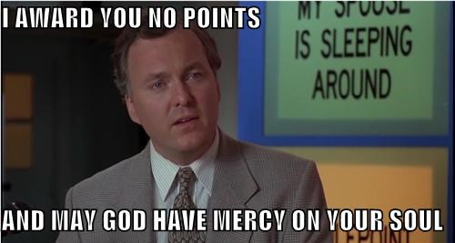
Google Maps does not count
Seriously…
You can use Google Maps if you want, but it will not count towards the advanced functions requirement.

Slide 25
Client
Access the web app
Example: IE, Firefox, iPhone, Chrome, Android
Presentation
Renders information, generates webpages
Example: HTML, DHTML, XML, Javascript
Manage data access, performs calculations, makes logical decisions
Example: ASP, PHP, Perl
Logic
Database
Stores and manages data
Example: MySQL, Oracle

Slide 26
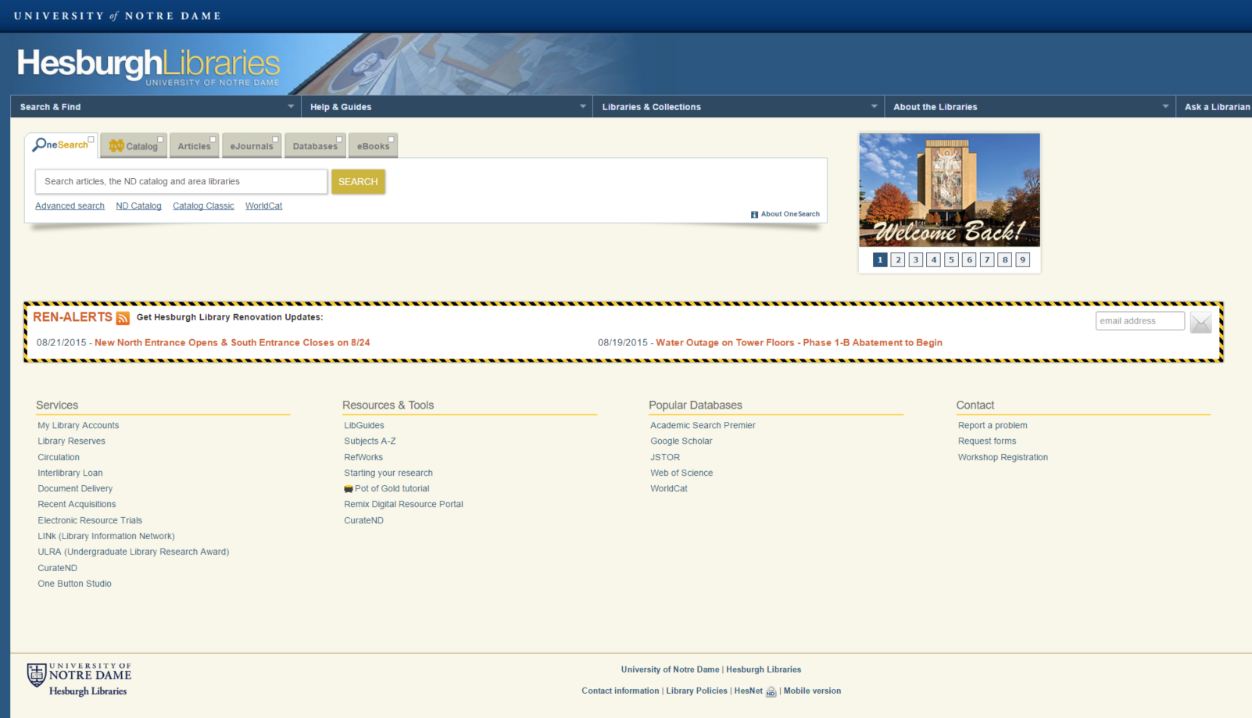
Client
Application is a website accessible via a web browser:
Presentation
Logic
Database

Slide 27
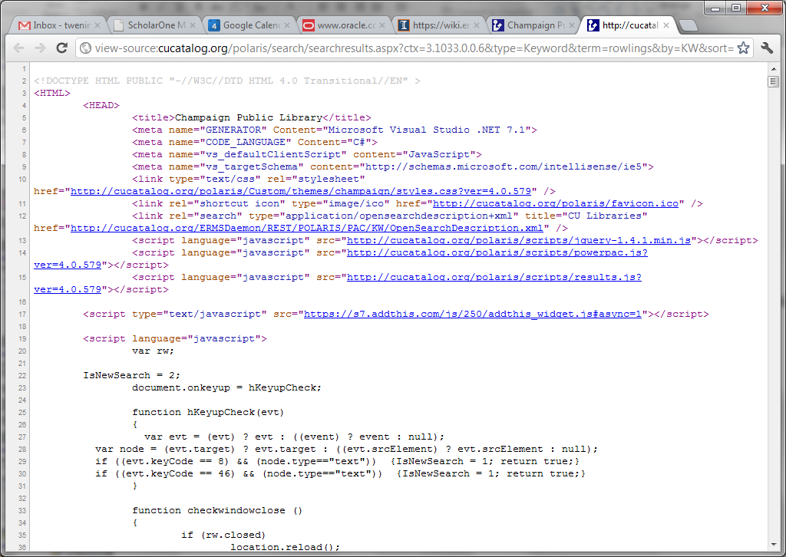
Client
Presentation
Use HTML and Javascript to create Web site
Logic
Database

Slide 28
Client
Presentation
Logic
PHP, et al., takes a string input and makes a SQL query
Database

Slide 29
Client
Presentation
Logic
Database
Mysql processes the query and returns results

Slide 30
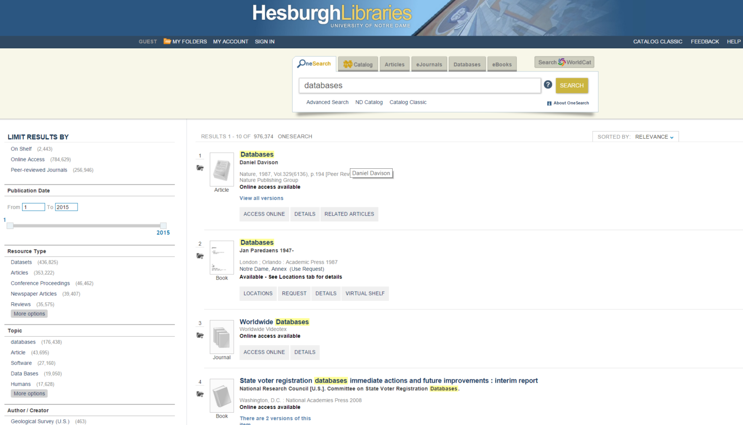
Client
Presentation
Logic
PHP, et al., processes the results, i.e., turns database objects into book records
Database

Slide 31
Client
Presentation
HTML and Javascript render the results
Logic
Database

Slide 32
Client
Client displays the results
Presentation
Logic
Database

Slide 33
Client
Client
Presentation
Internet
Server
Logic
Database

Slide 34
How to implement a Web application
Client
Client
Presentation
HTML, JavaScript, CSS
Logic
Database

Slide 35
How to implement a Web application
Client
Presentation
Server
Logic
PHP, ASP, Python, Java
Database

Slide 36
How to implement a Web application
Client
Presentation
LAMP – Linux, Apache, MySQL, PHP
Server
Logic
Web Server
Database
DB Server

Slide 37
Common tools for building web apps
Framework:
  LAMP
  Client side:
    Examples: CSS, Flash, HTML, DHTML, Javascipt
  Server side:
    Examples: ASP, Java, Perl, PHP, Python, Ruby
  Web server:
    Examples: Apache, Flask
  Database:
    Examples: MySQL, Oracle, Postgres

Slide 38
We will help you with project tutorials
Client
Client
Presentation
Web Programming
Logic
Server
DB Programming
Database

Slide 39
Project tips
Read Projects page on the Webpage to get started
I have provided development environment
  Database: MySQL
  Web server: Apache, Flask
Start early
  Unexpected issues
  Form groups now
Have a questions? Problem forming group?
  Post to Canvas

